Slide 1

PANORAMA USERS GUIDE
PANORAMA USERS GUIDE
THE KEY TALENT |C/ Velázquez 47, 7 izda, Madrid

Slide 2
INDEX
1. INTRODUCTION AND BASIC CONCEPTS ....................................................................................3
1.1 INTRODUCTION...................................................................................................................3
1.2 BASIC CONCEPTS .................................................................................................................3
1.2.1 Panorama Modules ......................................................................................................3
1.2.2 A Project in Panorama .................................................................................................3
1.2.3 Participant's Experience...............................................................................................4
1.2.4 Evaluation Variables.....................................................................................................6
1.2.5 Evaluation Tools Market ..............................................................................................6
1.2.6 Professional/ Results Report and Comments Report ..................................................7 1.2.7 Participants' data .........................................................................................................8
2. ACCESS ROLES ...........................................................................................................................9
3. ADMINISTRATION PANEL ....................................................................................................... 10
3.1 VIEW OF THE ADMIN CLIENT ........................................................................................... 10
3.1.1 Business Settings....................................................................................................... 11
3.1.2 Assessment Settings ................................................................................................. 12
3.1.3 Account Settings ....................................................................................................... 15
3.2 PROJECT MANAGER VIEW................................................................................................ 15
3.3 PLATFORM SET UP ........................................................................................................... 15
3.3.1 Creation of the Customer Account ........................................................................... 15
3.3.2 Customer authorization & delegated access (data protection regulation) .............. 15 3.3.3 New customer account request................................................................................ 15 3.3.4 Customizing Panorama for the customer ................................................................. 15
4. MANAGEMENT (PROJECT MANAGER) ................................................................................... 17
4.1 CREATION OF A NEW PROJECT ........................................................................................ 17
4.2 SETTING UP EVALUATION ................................................................................................ 17
4.2.1 Tool Configuration and Relationship with Variables................................................. 22 4.2.2 Weight allocation ...................................................................................................... 22
4.3 CREATING THE REFERENCE PROFILE ................................................................................ 23
4.4 LANDING PAGE................................................................................................................. 24
4.5 COMMUNICATION ........................................................................................................... 26
4.6 REPORT ............................................................................................................................ 26
4.6.1 PARTICIPANT'S REPORT ............................................................................................ 27
4.6.2 Feedback report ........................................................................................................ 28
4.7 OVERVIEW........................................................................................................................ 29
4.8 ADDING PARTICIPANTS .................................................................................................... 30

Slide 3
4.8.1 Create New ............................................................................................................... 30
4.8.2 Excel upload & participants metadata ...................................................................... 30
4.8.3 From the directory .................................................................................................... 31
4.9 ADDING ADVISORS........................................................................................................... 31
4.10 PLANNING ...................................................................................................................... 32
4.10.1 One by One Planning .............................................................................................. 32
4.10.2 Multiplanner ........................................................................................................... 33
4.11 LAUNCHING A PROJECT ................................................................................................. 34
4.12 PROJECT STATISTICS....................................................................................................... 35
4.13 OTHER ACTIONS CARRIED OUT ON PARTICIPANTS........................................................ 35
4.13.1 Remind participant ................................................................................................. 35
4.13.2 Pause a participant ................................................................................................. 35
4.13.3 Drop a participant ................................................................................................... 35
4.13.4 Sharing participant's report .................................................................................... 35
4.13.5 Sharing participant's report feedback..................................................................... 36
5. ASSESSOR ............................................................................................................................... 37
5.1 INTRODUCTION................................................................................................................ 37
5.2 SCHEDULING INTERVIEWS ............................................................................................... 37
5.3 CONDUCTING INTERVIEWS .............................................................................................. 38
5.4 REPORTING ...................................................................................................................... 40
5.4.1 Results Report ........................................................................................................... 40
5.4.2 Comments Report ..................................................................................................... 41
6. PEOPLE ............................................................................................................................... 43

Slide 4
INTRODUCTION AND BASIC CONCEPTS
  INTRODUCTION
This guide is intended to provide an initial introduction to the platform in terms of its basic functionalities, it is not intended to be a detailed users guide, but rather a reference point for best practice in order to facilitate the user in the use of Panorama.
This guide is a “living” document subject to change due to the fact that Panorama is a platform that is currently in development. The main sections of this document and their content are subject to change (they may be extended, reduced or even eliminated altogether).
  BASIC CONCEPTS
    Panorama Modules
We will now define each of Panoramas modules, as well as explain them in further detail later in this document:
ADMINISTRATION PANEL
This is the section from which the platform will be configured according to the type of profile you have been assigned; some profile/users will have a limited view. They are defined below:
  Client Admin Profile → Will be able to configure the mobility options and preferences of the participants that will appear in the HUB, create or modify evaluation variables and their relationships with the evaluation tools, as well as create the coordinates that will appear as metadata for each of the participants in the platform (up to a maximum of 10). The client admin will also be able to visualize the consumption of tests made by the participants of the third-party tools integrated with Panorama.
  Project Manager profile → Will only be able to create or modify evaluation variables and their relationships with the evaluation tools.
MANAGEMENT MODULE
This the main module of the Project Manager's Profile, from this module you can create and manage all those projects that belong to the manager profile.
CONSULTANTS/EVALUATORS MODULE
This is the main module of the Advisors or Evaluators Profile, from which they can schedule and carry out the interviews with the participants, as well as make the results reports and introduce comments of each of the participants assigned to them in these phases.
PEOPLE MODULE
In this module we can find the list with all the people included in the platform.
In the near future, by clicking on each of the people on the list, we will be able to consult their personal information, as well as the results of the projects in which they have previously participated. At the moment, this is a functionality that is under development and is not currently available on the platform.
1.2.2 A Project in Panorama
A Project in Panorama is the journey that a participant must take from beginning to end in order to complete a designated process.

Slide 5
The nature of a Project can vary, from an Evaluation Process, a Development Process, a National or International Geographic Mobility Process a Re-Skilling Process or any type of process that allows us to measure or better understand the competencies, skills and desires of the company's employees.
To create a Project of any nature in Panorama you must be logged in to the profile of "Project Manager" within the platform. This profile will be assigned to you by the platform administrators.
There are three types of projects in the pipeline:
Sequential Projects → These are projects that follow the canonical process of the Evaluation Process where one test after another is carried out in a linear manner, and where the participant will have prior knowledge of what all the tests are as soon as he/she is invited to the project.
Hidden Sequential Projects →They have the same nature as the Sequential Projects; however, the difference is that the participant does not know his next test until he has finished the previous one.
Free Projects → are those projects that the participant sees all his "journey" and can go through the tests in the order he deems appropriate.
    Participant's Experience
A participant in Panorama will have an easy and enjoyable experience that will give him the possibility to complete each of the projects assigned to him through the following tools:
      Participant's HUB
This is the space where each of the employees participating in one or several Projects will be able to see what the status of each of their assigned projects is (to begin, view or continuethe next steps to be carried out). They will be able to access the projects from this space, by simply clicking on the Project they want to enter.
The participant's HUB will also be able to collect qualitative information about the participants, in terms of preferences, mobility, etc.
      Project Landing Page
This is the main site of a Project, the main interaction point where the employee can visualize the information and description of the Project and the instructions they will need to follow.
This "landing page" can be accessed either from the invitation e-mail sent to each of the Project participants, or from the participant's HUB by clicking on the Project we want to access. It will also be possible to access this "landing page" from the project control screen by accessing the participant information and clicking on More info.
From this "landing page", when clicking on each of the tests that appear on it, the participant will be automatically redirected to the selected test, if it is already available for him.

Slide 6
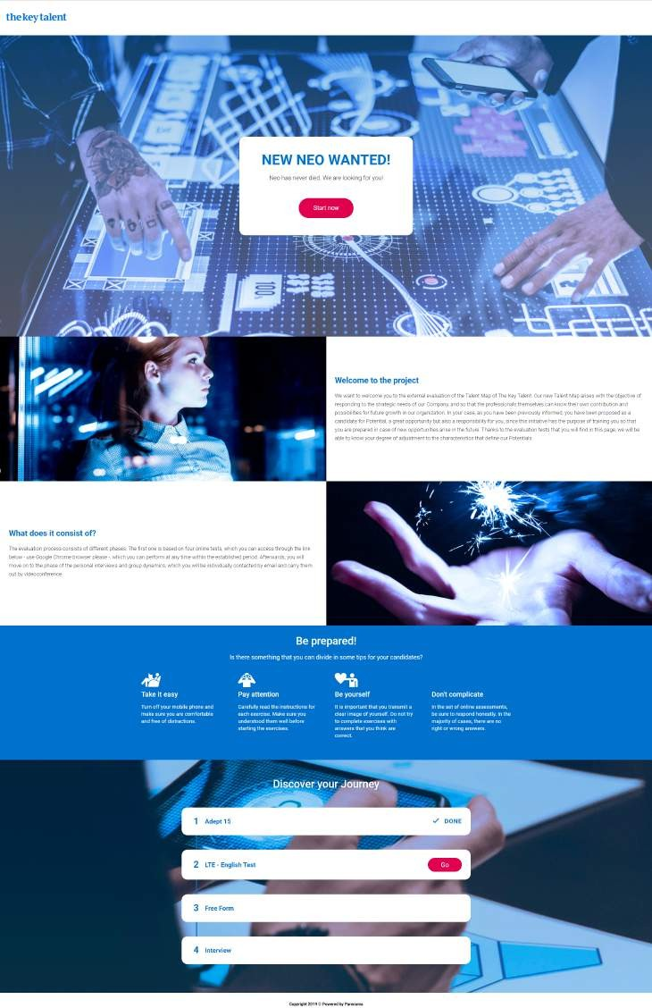

Slide 7
Participant's "Journey
A participant's "journey" is each of the tests and actions that the participant has to perform in order to complete the Project.
The journey can be visualized by the participant in the "landing page", checking which test is the next to be done or in some cases it can be hidden and only appear as the previous test is done.
Participants view of Report Comments
This is the web page from which the participant can view the comments that correspond to their own report from the project. They would have previously received an email indicating that they can see these results.
    Evaluation Variables
The "Evaluation Variables" are the variables that we want to evaluate a participant with within a corresponding Project, there are several types of "Evaluation Variables", which we will now define:
      Competencies or Enablers
Each of the competencies or enablers is either a predefined model such as ADEPT-15, Shapes, or those defined by each company to evaluate its employees.
These competencies are divided and defined in sequential levels that will later be the definitions included in the results reports delivered, according to the scores obtained in the tests that measure that "competency or enabler" by a participant.
These variables can be measured by different evaluation tests that will be configured by the platform administrator or the Project Manager for their correct use.
      Skills
Are each and every one of the variables that are disposable to evaluate the abilities of the participants such as: languages, logical and attention skills, etc.
      Knowledge
These are those variables that the customer defines as relevant for evaluation purposes for his/her employees. We must also define with which tools we want to evaluate these variables.
      Organizational
The "Organizational Variables" are the variables defined by each organization to evaluate its employees.
      Digital
These are the variables that are capable of measuring the digital competencies of the participants in those projects in which this type of evaluation is to be carried out.
    Evaluation Tools Market
Panorama has a "market" of tools where you can access the tools with which we want to evaluate/measure the competenciess or skills of the participants in a Project.

Slide 8
These tools can be the client's own- or third-party tools integrated within the platform.
The Market of Tools are divided into different sections according to how they are used, these sections are:
Online Tools,
Onsite Tools
Tools that require interaction with the evaluator or one to one and the Results Tools (corresponds to the reports of results and comments).
Evaluation Tool
The "Evaluation Tools", are clients tools as well as those from third parties that allow you to evaluate the competencies or skills of a participant in a Project, you find and add them through the "tools market".
There is the possibility of integrating the organization’s own assessment tools into this "market”.
These tools allow you to obtain quantitative information from the participants, that will then be reflected in the final reports.
This type of tools can be online or face to face enabled.
Other Tools
These are tools that collect qualitative information from employees in order to find out information such as their aspirations, preferences for internal mobility, geographical mobility, etc, this type of tools are:
  Announcements → that among other things allow you to request the mobility preferences of the participants.
  Free forms → that allow us to collect (via questions of a different nature) information from the participants which can be viewed at that stage of the
project in each of the participants.
Market Structure and Tools
The Tool Market is divided into 4 groups according to the nature of the tests: Online Tests, Onsite Tests, One to One Tests and Results Reports, so when selecting each of the tests in these sections the participant must perform them as established in the platform.
    Professional/ Results Report and Comments Report
The Results and Comments Reports are the reports that are automatically generated as the participants carry out the tests assigned to them in a Project, as well as after the evaluations of the interviews that the assigned evaluator/assessor has done.
      Professional or Results Report
The Results Report is the report provided by Panorama to the HR department, it may or may not be shared with the participant's managers, where both quantitative and qualitative information about the participant in the Project is gathered. This report provides quantitative information, as well as ratings and adjustment (or not) to a

Slide 9
reference profile, it shows the areas of Strength or Improvement of the participant, as well as indicates how he can develop the areas in which he needs to improve.
Feedback Report
The Feedback report is the report that can be given to the participant in the Feedback session where qualitative information is shown, there is no quantitative information and no adjustment or mismatch with a reference profile.
This report can also be visualized by the participant himself from the link that will be provided via e-mail, which will send him to his landing page, appearing a new phase to redirect him to the web where he can consult it.
    Participants' data
In this section you can find both the employees' data as to which projects they currently in or have been participating in, as well as collecting all the information related to the employee's mobility preferences.
      Employee HUB and Mobility Preferences
In the employee's HUB as well as in the participants ,we can find both the projects in which they are registered and their status, as well as the mobility preferences indicated by the employees and therefore registered in the system.

Slide 10
ACCESS ROLES
Panorama users are as follows:
  Partners: these are the people in charge of helping customers both in the configuration and the launching of projects to make them successful. They can also be part of the evaluation process of a project, as well as being the delegated administrator of a given customer's platform (having been previously authorized by the customer).
Panorama profiles
  Client Admin: is the person who administers the platform, with the capacity to configure and integrate everything related to it: metadata (organization, manager, employee id, function, department...), corporate image, own or third party tools, evaluation variables, etc.
  Project Manager (PM): responsible for the creation and administration of projects within the platform, this profile will be assigned by the platform administrators to the person in charge of configuring and launching the projects.
  Evaluator / Assessor: is the person in charge of evaluating the participants assigned to him in the platform, this profile and assignments are provided by the PM responsible for the Project. This person will be in charge of filling in and conducting interviews, as well as filling in the Results Report and finally conducting and filling in the data from the Commentary sessions.
  Participant: These are the employees/candidates who are assigned to a Project. This profile is provided by the Project Manager responsible for the Project to which they have been assigned.
Next, we are going to define, in a more detailed way each of Panoramas modules, as well as the actions that can be performed within them.

Slide 11


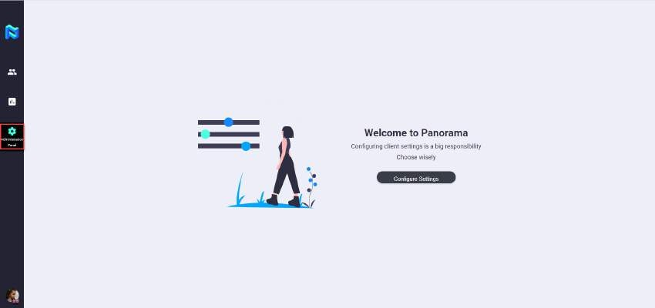
ADMINISTRATION PANEL
In this section we are going to describe the functionalities of the Administration Panel, according to the type of profile you have been assigned inside the platform.
¡ALWAYS REMEMBER! All the information configured in the Administration Panel, will be visible in the platform (variables, look and feel, preferences, mobilityoptions, etc…
  VIEW OF THE ADMIN CLIENT
The "Client Admin", is the administrator of the platform and is responsible for configuring the platform to the client’s needs/specifications.
To configure the platform, the Client Admin must access the "Administration Panel" icon on the left hand side bar of the platform or click on the "Configure Options" button.
Once we access the Administration Panel, we access a Menu where by clicking on each of the options we can configure different types of data inputs for the platform.

Slide 12
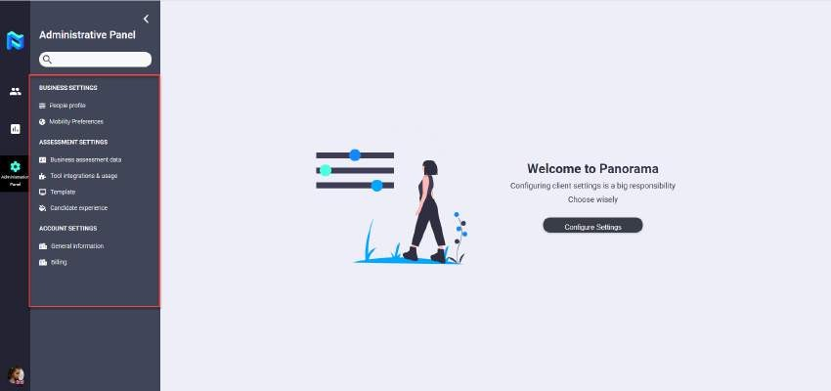
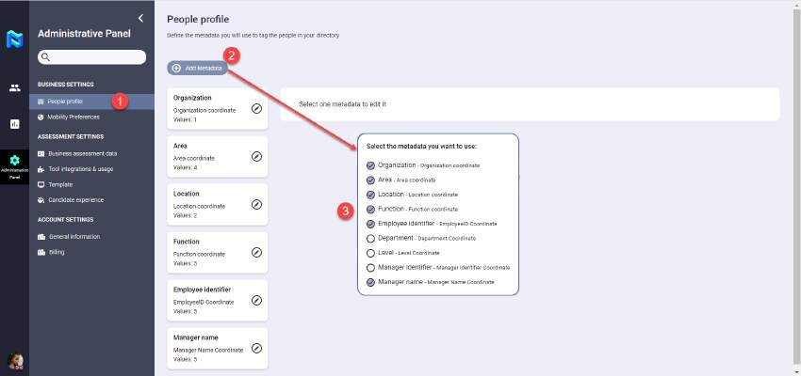
    Business Settings
From this area of the platform we can define both the People profile and configure the Mobility Preferences that will appear in the participant's HUB.
      People profile: In this section we will be able to add or remove variables, as well as edit the metadata or coordinates that will appear as information of the people within the platform and through which we will be able to filter the information of the participants. To do this, we will enter by clicking on the link "People profile" .To add or remove a new one we will click on the button "Add metadata", where a drop-down menu will appear and where we will be able to select or unselect by means of checking those options that are predefined in the platform, as shown below.
If we want to edit a metadata we should click on the pencil icon that appears to the right of its definition and modify its existing data or add new values to it, confirming this edition by clicking on the "Save" button or discarding it by clicking on the "Cancel" button.

Slide 13
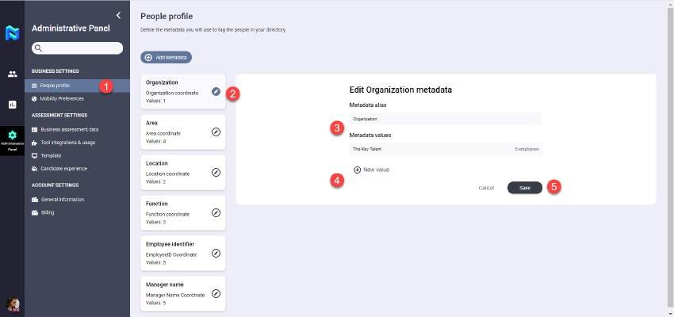
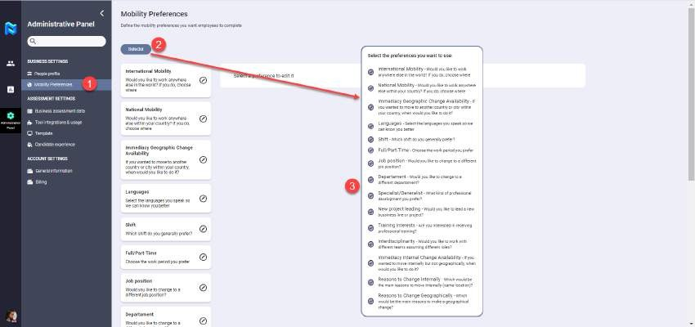
Mobility preferences: In this section we can activate or deactivate, as well as edit all those mobility preferences just by clicking on the "Selector" button and selecting from the drop-down menu all those we want to appear. We must then click on the pencil icon that appears to the right of its definition to activate or deactivate the information we want to appear just by activating the button that appears to the right of it and confirm or discard its selection just by clicking on the "Save" or "Cancel" button. This allows the client to collect qualitative information from his employees, leaving this information collected within the platform.
3.1.2 Assessment Settings
In this area of the Administration Panel we can define and configure, as well as edit the evaluation variables that we want to define within the platform. We can also consult the integrations with the evaluation tools that we have in our platform and the use of these tools by the participants. In the future we will be able to define the templates for the "Landing page", as well as the image of the company, these last two functionalities are currently under development and will be available shortly.

Slide 14


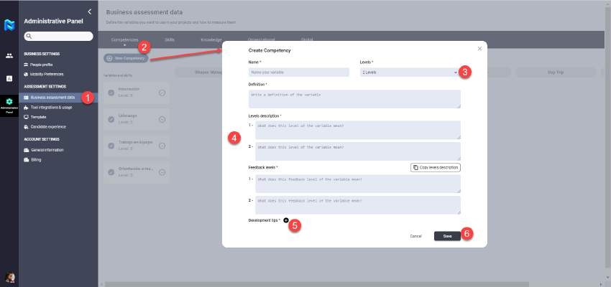

¡ALWAYS REMEMBER! All the information defined within the Assessment Data, will be the information that will later be visible in the Results Reports and Comments. The levelled definitions will automatically appear in their sections.
Business assessment data: This section of the platform is where we can define, edit and map each of the assessment variables.
To define any of the evaluation variable types you must click on the link Business assessment data, click on the button new variable type, select the level or scale of the variable to be defined, and fill in the fields, name, definition, level definition and compulsory feedback level definition. On the other hand, you can also define this options from "Development tips" for that variable, to confirm or discard the data entered from the variable definition you must click on the button “Save” or “Cancel”.
To configure the tools with which we want the defined variable to be evaluated, we have to check between the variable and the tool. If the tool needs to be configured or mapped it will appear highlighted in orange with an icon with a gear to perform the necessary actions. In the case of the interviews, the questions and indicators that can be selected in the configuration of the interview of a project will be created here.
¡IMPORTANT! You must take into consideration that in order to configure a project in Panorama, you must have previously defined in the Administration Panel all of the variables and their consequent interactions with the selected assessment tools.

Slide 15
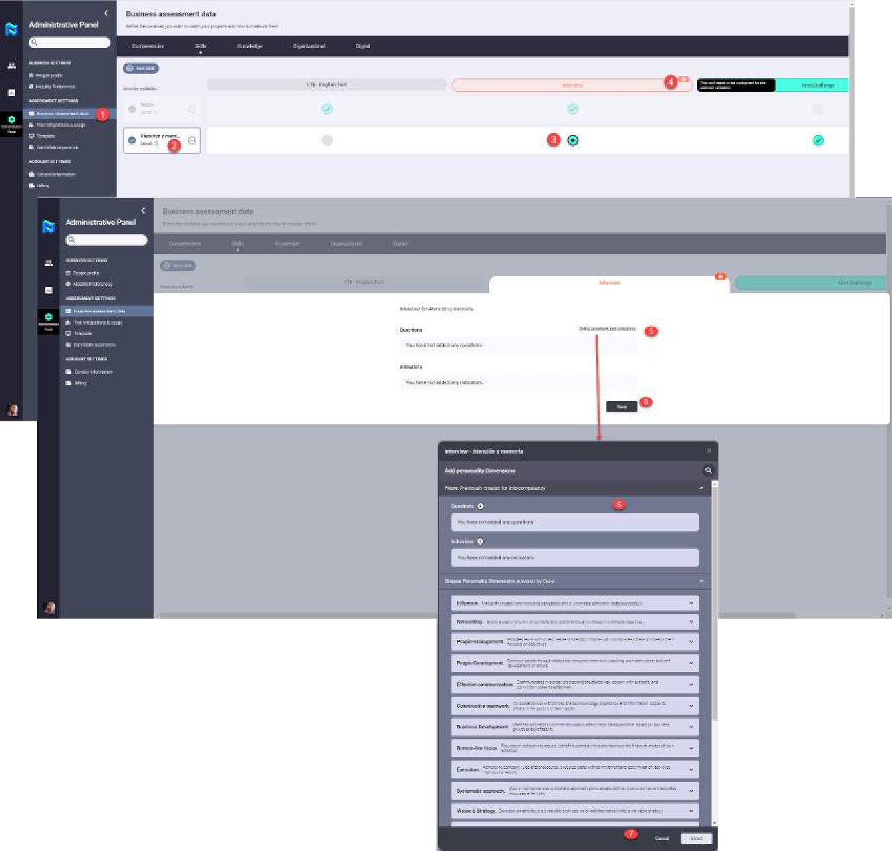
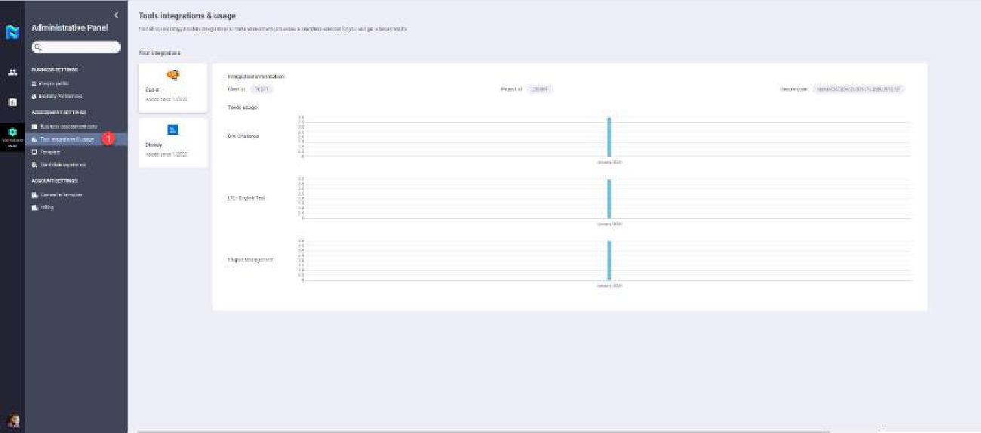
Integration and use of tools (Tools integrations & usage): in this section of the administration panel we will be able to consult all the Integrated tools, as well as the use of the same ones on the part of the participants in graphical form.

Slide 16
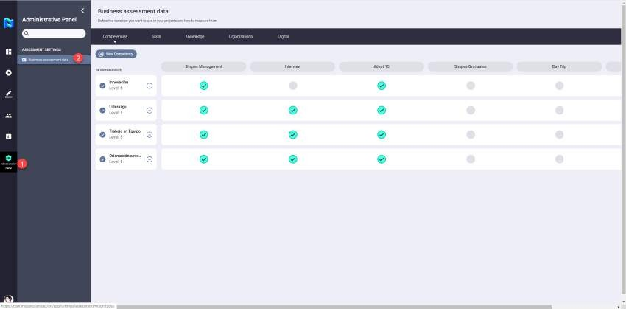
3.1.3 Account Settings
In this area of the Administration Panel you will find the general information functionalities of the platform and the billing of test consumption in the same by the employees who have been consuming them. These last two functionalities are currently under development and therefore will be available in the near future.
3.2 PROJECT MANAGER VIEW
With regards to the view of the Project Manager of the Administration Panel, we can say that he will only have the possibility to access the Business assessment data section. Here he/she will be able to define, edit and map each of the assessment variables, in the same way as explained for the Client Admin.
  PLATFORM SET UP
    Creation of the Customer Account
In the following section, we will detail how the delegated administration of the platform by the client to a partner will be done in the future. The functionality of delegated administration is currently under development, so its use requires prior authorization by the customer.
    Customer authorization & delegated access (data protection regulation)
This is the authorization given by a client to third parties to access the data on the platform, as this is sensitive information protected under the GDPR.
    New customer account request
It corresponds to a request by the client for a user account on the platform.
    Customizing Panorama for the customer
Relates to the adaptation of the platform to the client's needs, as well as the introduction of its logo, and corporate colors to the Communications (emails, notifications etc…) with its employees.
      Languages
In this area we will introduce the clients working languages in an easy and efficient way with all the participants involved in a Project.

Slide 17
Client's competency model & variables
In this area we will introduce both the scale via which we want to measure the projects, as well as the definition of the model of competencies. Defining each one of them and their levels, as well as the "development tips" for and the variables and skills to be measured in the possible projects carried out by that client.
Employees metadata
They correspond to all the data that can be filtered in the platform in order to enable the grouping of candidates in fast and simple into appropriate categories.
Branding, communications, etc.
Configuration of the "look and feel" of the client (colors, logos, dictionary...), as well as the communications of the projects (emails, notifications etc..) to the different participants involved in them.
Internal mobility preferences
This area will define all the internal mobility preferences that the customer wants to be asked to his employees in order to collect qualitative information and enter it in the platform to have it available at any time to be consulted.
Tools integrations
This area will define all the tools that will be integrated within the platform, whether they are our own or those of third parties.

Slide 18
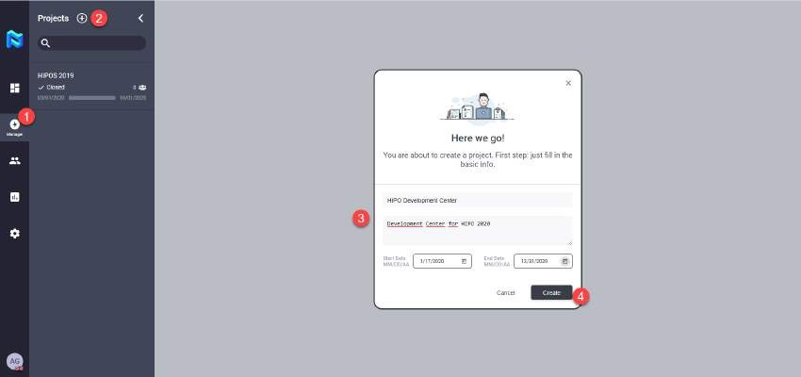
MANAGEMENT (PROJECT MANAGER)
  CREATION OF A NEW PROJECT
To create a new project, we must have a "Project Manager" profile, within Panorama, previously requested to the Panorama (The Key Talent) administrator.
To create a project in Panorama you just have to click on the plus side bar of the project area, write in a name, a description, a start and end dates and click on the Create button in the next screen:
In Panorama a project is understood as a folder where all the information associated to the participants involved in the project is gathered, where the quantitative and qualitative information collected during the project process is found.
This information can be contrasted, classified, ordered or used according to each case in order to carry out the necessary actions with each of the participants, invite them to new projects, facilitate building processes, new vacancies in the company, etc.
4.2 SETTING UP EVALUATION
To access the Configuration Area of a project we only need to click on the gear icon located in the upper right corner of the Project control area as shown in the following image:

Slide 19
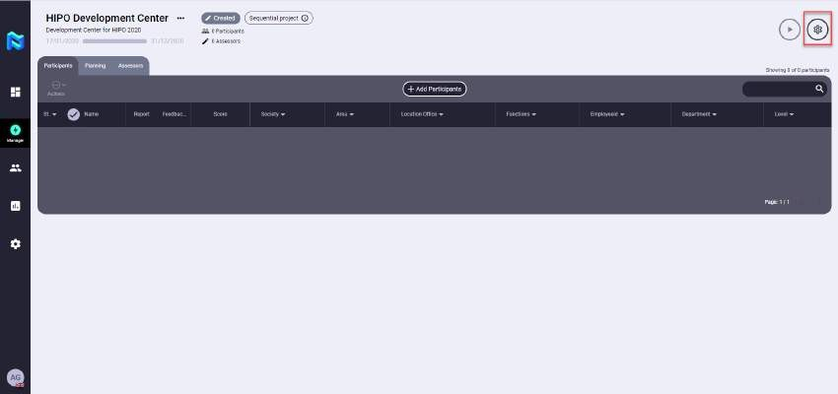
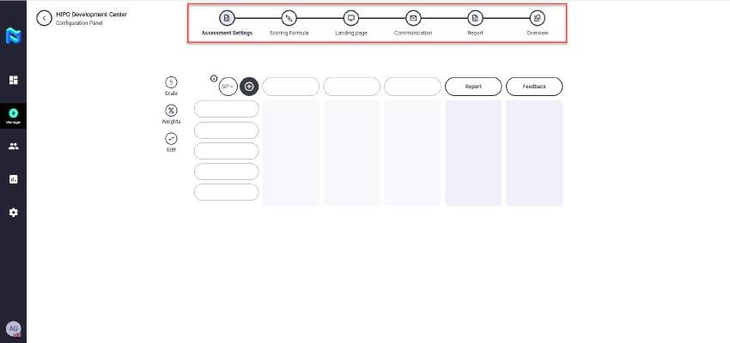
After this we will enter the Configuration Area where we will select the scale on which we want to measure the Project if this was not previously predefined in the client's configuration area.
Journey sequence
These are the steps to follow in order to configure a Project before launching it, they are found in the upper part of the Project Setup screen as if they were a timeline, as shown in the following screen.
Project Type Selection
To select the type of project we want to create according to its sequence, we must click on the icon that appears in the upper left corner of the matrix and select one of the 3 options:
o Sequential Projects → These are the projects that follow the canonical process of the Evaluation where one test after another is carried out in a linear way, and where the participant will be able to know all the tests as soon as he is invited.

Slide 20
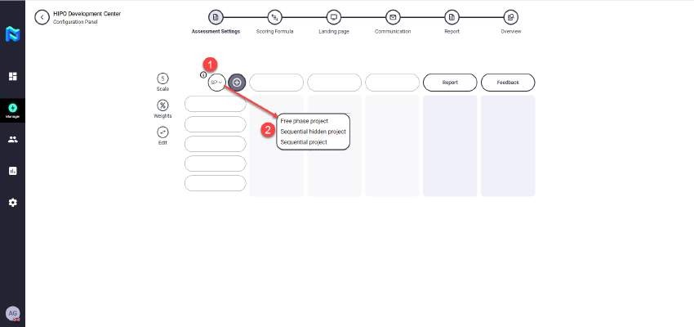
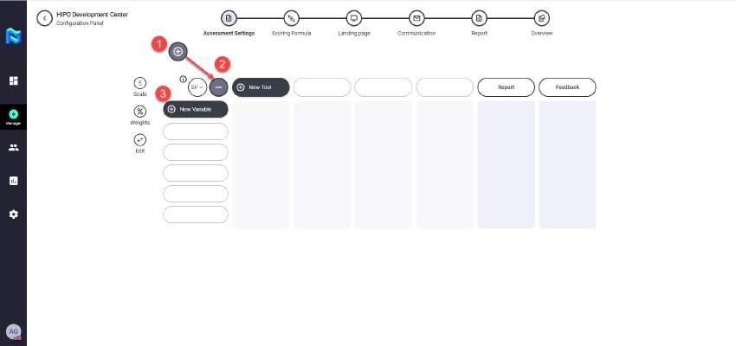

Hidden Sequential Projects → They are of the same nature as Sequential Projects, the only difference being that the participant does not know his next test until he has finished the previous one.
Free Projects → These are those projects that the participant sees his whole "journey" and can do the tests in the order he considers appropriate.
Variables to be evaluated
These are all those variables (skills, abilities, knowledge, values,) that we want to measure within a project. To add them we only have to click on the plus, which appears in the upper left corner of the matrix and add them directly as they were previously predefined within the Administration Panel, either by the Client Admin or by the Project Manager.
¡IMPORTANT! You must take into consideration that you will view the variables previously defined in the Administration Panel, either by the Client Admin or the Project Manager.

Slide 21
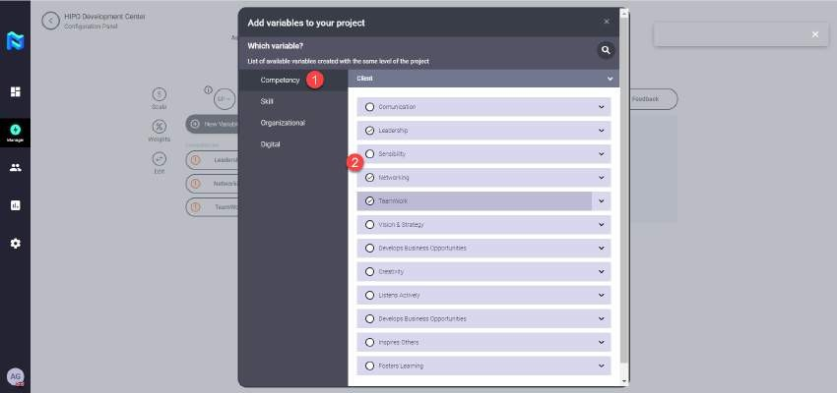

Evaluation Tools
These are all the tools, that belong to the client, AON or third parties, that are integrated within the platform and that serve to evaluate each of the variables that we have previously selected for our project. To access and select them, just click on the More button in the upper left corner of the matrix, and a marketplace will open where you can select each of the desired tools, as shown below.
We have to take into account that for each tool to be well configured it has to be correctly configured and mapped in the Administration Panel, otherwise its name will appear in orange in the matrix and we will have to access to this panel to configure it for the selected variable.
¡IMPORTANT! You must take into consideration that in order to properly set up Panorama, the Administration Panel must be previously configured correctly, in terms of configuration and mapping. If not the consequence of this will be the name appearing in orange writing, this will mean the Client Admin or Project Manager will have to go back and reconfigure.

Slide 22
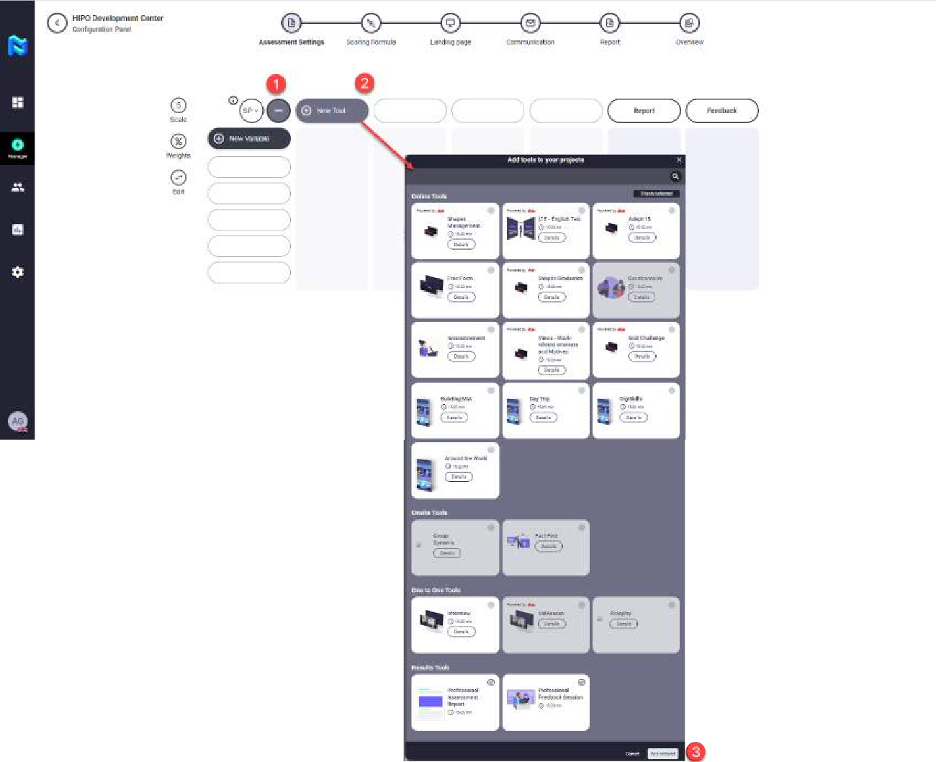
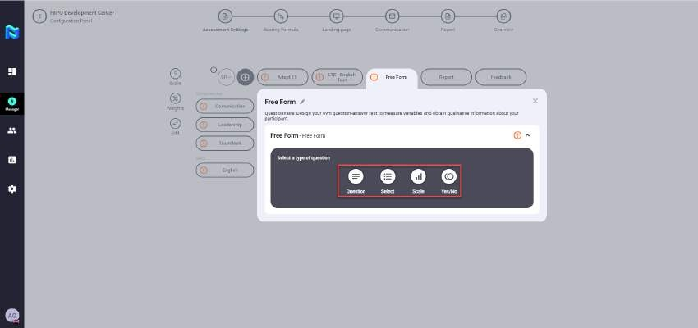
Free Forms
It is a tool that collects qualitative data from the participants, with this tool we can ask them questions to find out their preferences for mobility, training, degree of satisfaction, or any free evaluation question that we want to ask them in order to obtain data.

Slide 23
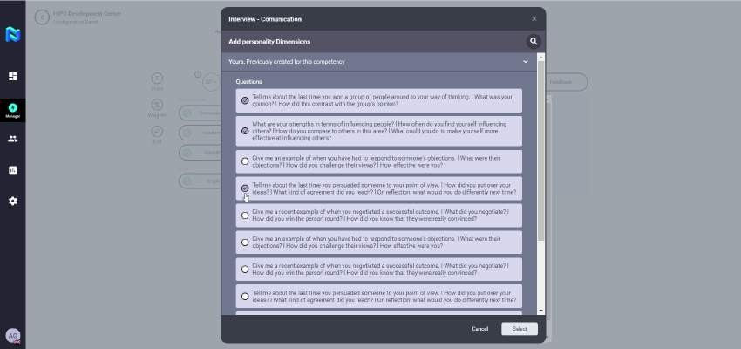
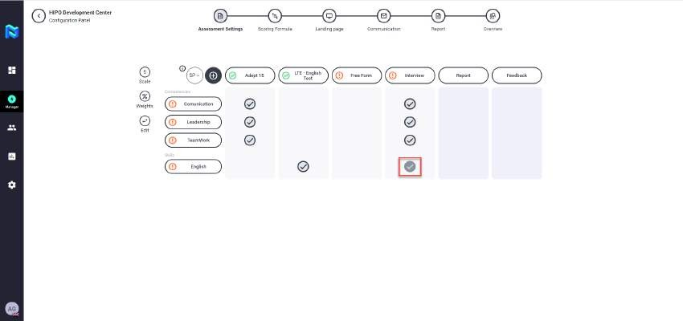
Interviews
Both your questions and indicators were previously configured in the Administration Panel by the Project manager or by the Client Admin, for each of the variables that require this type of test. During the matrix configuration process, we will be able to select any of the questions or indicators previously defined just by selecting them.
4.2.1 Tool Configuration and Relationship with Variables
Once the variables and the tools with which we want to evaluate have been selected, we must relate them by selecting the corresponding check within the matrix by simply clicking within the bubble that marks them.
4.2.2 Weight allocation
Finally, to finish configuring the matrix of variables per test we must assign the weights we want each of the tests to have for each variable selected for them. To do this, we only need to click on the "Weighing" icon, filling in the desired percentage for each test in each variable, and by clicking on the "check", we will configure the selected weights.

Slide 24
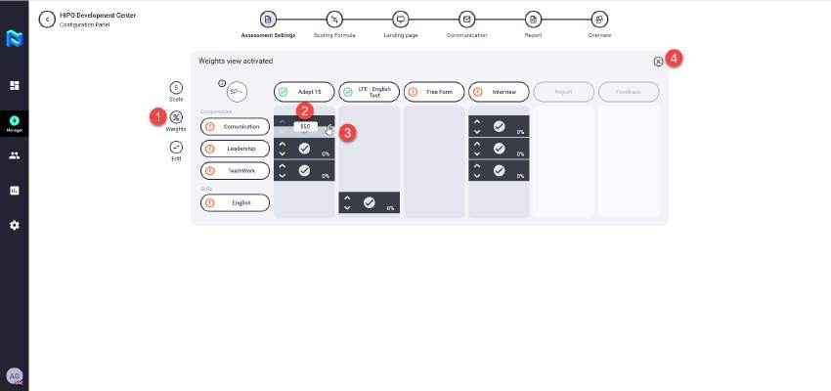


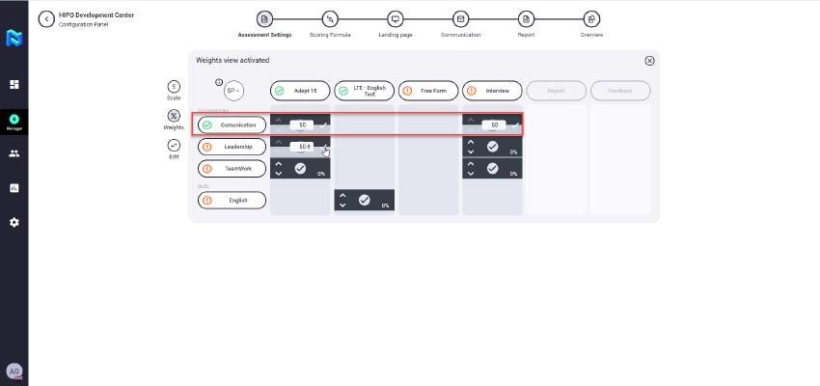
¡ALWAYS REMEMBER! Each line of the matrix must have a final numerical score adding up to 100% so the matrix is configured correctly. If not, the variable will not appear checked in green further down the process.
4.3 CREATING THE REFERENCE PROFILE
In this step of the project we create all those formulas with which we want to measure and evaluate the Project we are creating, choosing to do so, which variables we want to weight and with what percentage.
If the variable chosen is one or several competences, we must select the reference profile that we want to evaluate. Once the formula is created, we only have to click on the bubble and select the scale we want to use. Remember that in order to save an evaluation formula it must have a name, otherwise the formula will not be saved in the project, just as all the variables in the formula must add up to 100%.

Slide 25
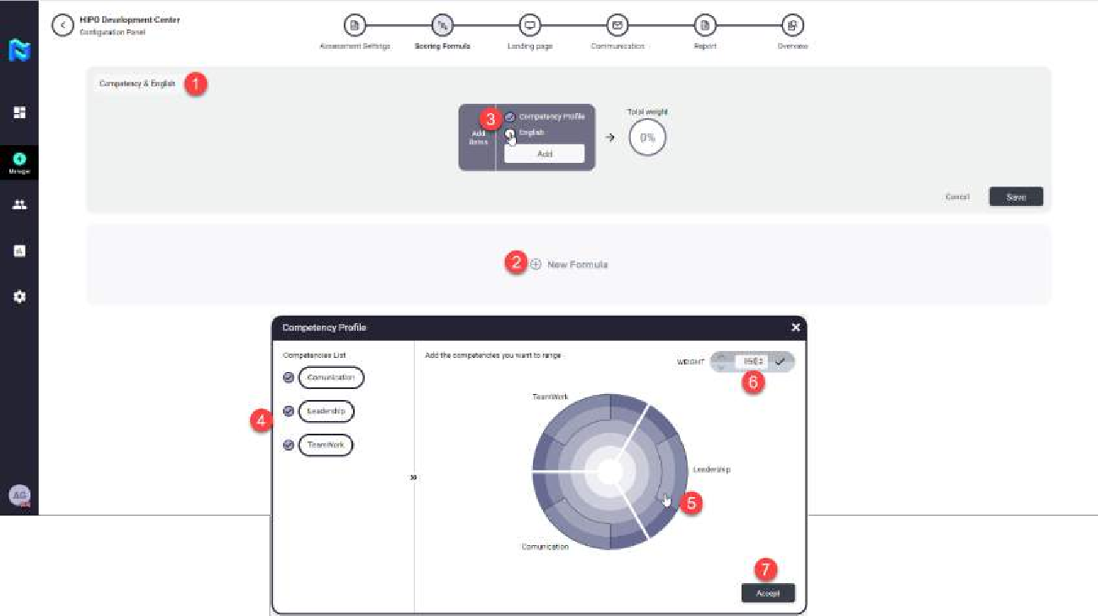


¡ALWAYS REMEMBER! In order to save an evaluation formula, it must have a name, otherwise the formula will not save to its corresponding project. In this case all of the formula variables must also sum up to 100%.
4.4 LANDING PAGE
This is the access point or site of the Project that we are configuring. In this step of the "journey sequence" we will be able to preview how the page that the participant will receive will look like with the relation of each of the tests that he or she has to do to complete the process.
The "landing page" can be adapted to the client's colors, images, messages and logo.

Slide 26
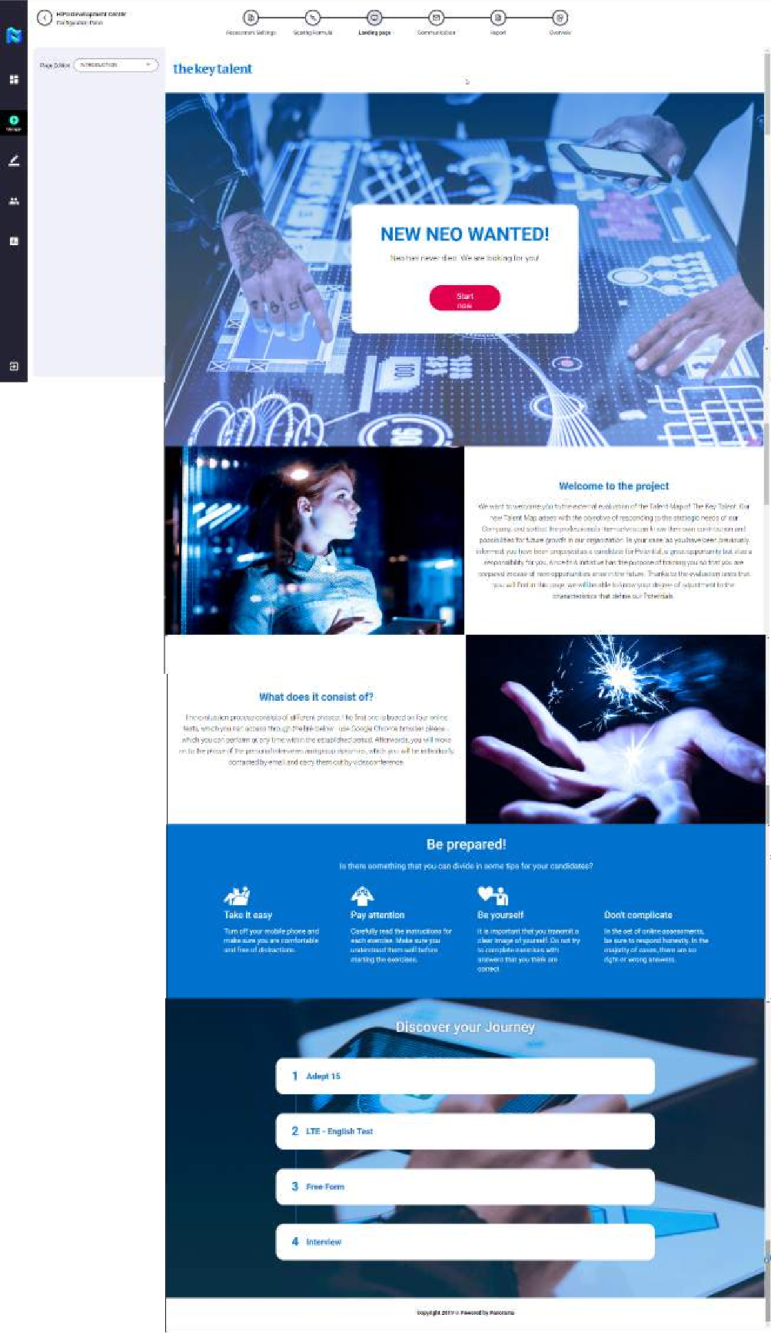

Slide 27
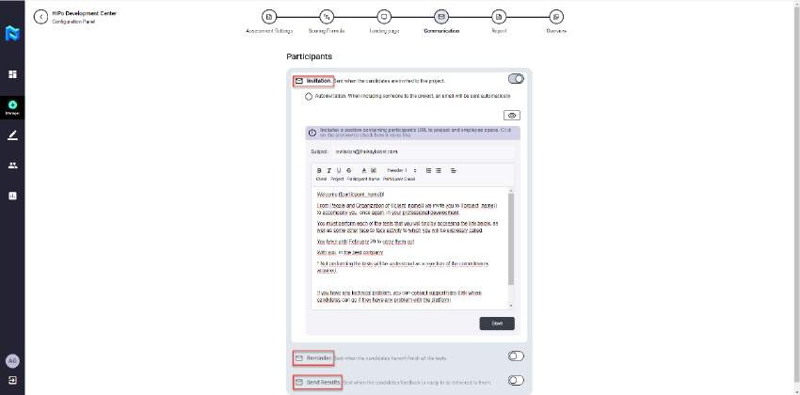
4.5 COMMUNICATION
In this section of the "journey sequence", what we can configure are the messages of both: invitation, reminder or and completion of the project for the participants. These communications can be adapted to the client's colors and logo previously defined by the Client Admin in the Administration Panel.
Invitation
This is the text that will be defined for a participant to be notified by email of their invitation to a project. This invitation can be manual, made by the Project manager or automatic if in the configuration of the same we check the Autoinvitation tick. In the case that this check is marked once, the Project Manager launches the project, all participants who have been added to it will receive an email with their invitation to the project.
Reminder
This is the text that will be defined for a participant to be notified by email, reminding him that he still has pending tests for the project corresponding to the reminder email. This is a manual process currently to be carried out by the Project Manager, but in the future this functionality will be automatic.
Sending Results
This is the text that will be defined for a participant to be notified by email with access to the web of results of the project that is being informed and in which he has participated. This sending of results is optional, i.e. if the client does not wish it, he does not have to send these results to the participants of a project. This is a manual process at the moment that has to be done by the Project Manager, but in the future this functionality will be automatic if the client defines it.
4.6 REPORT
In this section of the "journey sequence", what we will be able to consult will be a template of the participant's results report (that will be delivered to HR) and the comments report that will be shown via the web to the participant at the end of the process.

Slide 28
4.6.1 PARTICIPANT'S REPORT
This is the report that is delivered to the HR department and is automatically created as the participant performs each of the tests assigned to his process. A fictitious preview of the process is obtained in the "journey sequence" step called "Report", the actual report of each of the participants will be available in the "journey" of each participant in the control panel of the Project Manager and the Advisor / Evaluator of those participants to whom he has been assigned.
This report contains the scores obtained by the participant, as well as the adjustment to the reference profile set, thus giving quantitative information of the results obtained in the process.

Slide 29
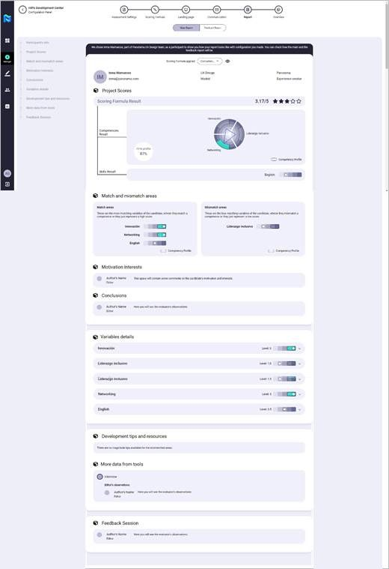
4.6.2 Feedback report
This is the report that is delivered via web to the employee/participant and that is automatically created as the participant performs each of the assigned tests of his/her process.
A “mock” preview of the same is obtained in the step of the "journey sequence" called "Report", the real report of each of the participants will be available in the "journey" of each participant

Slide 30
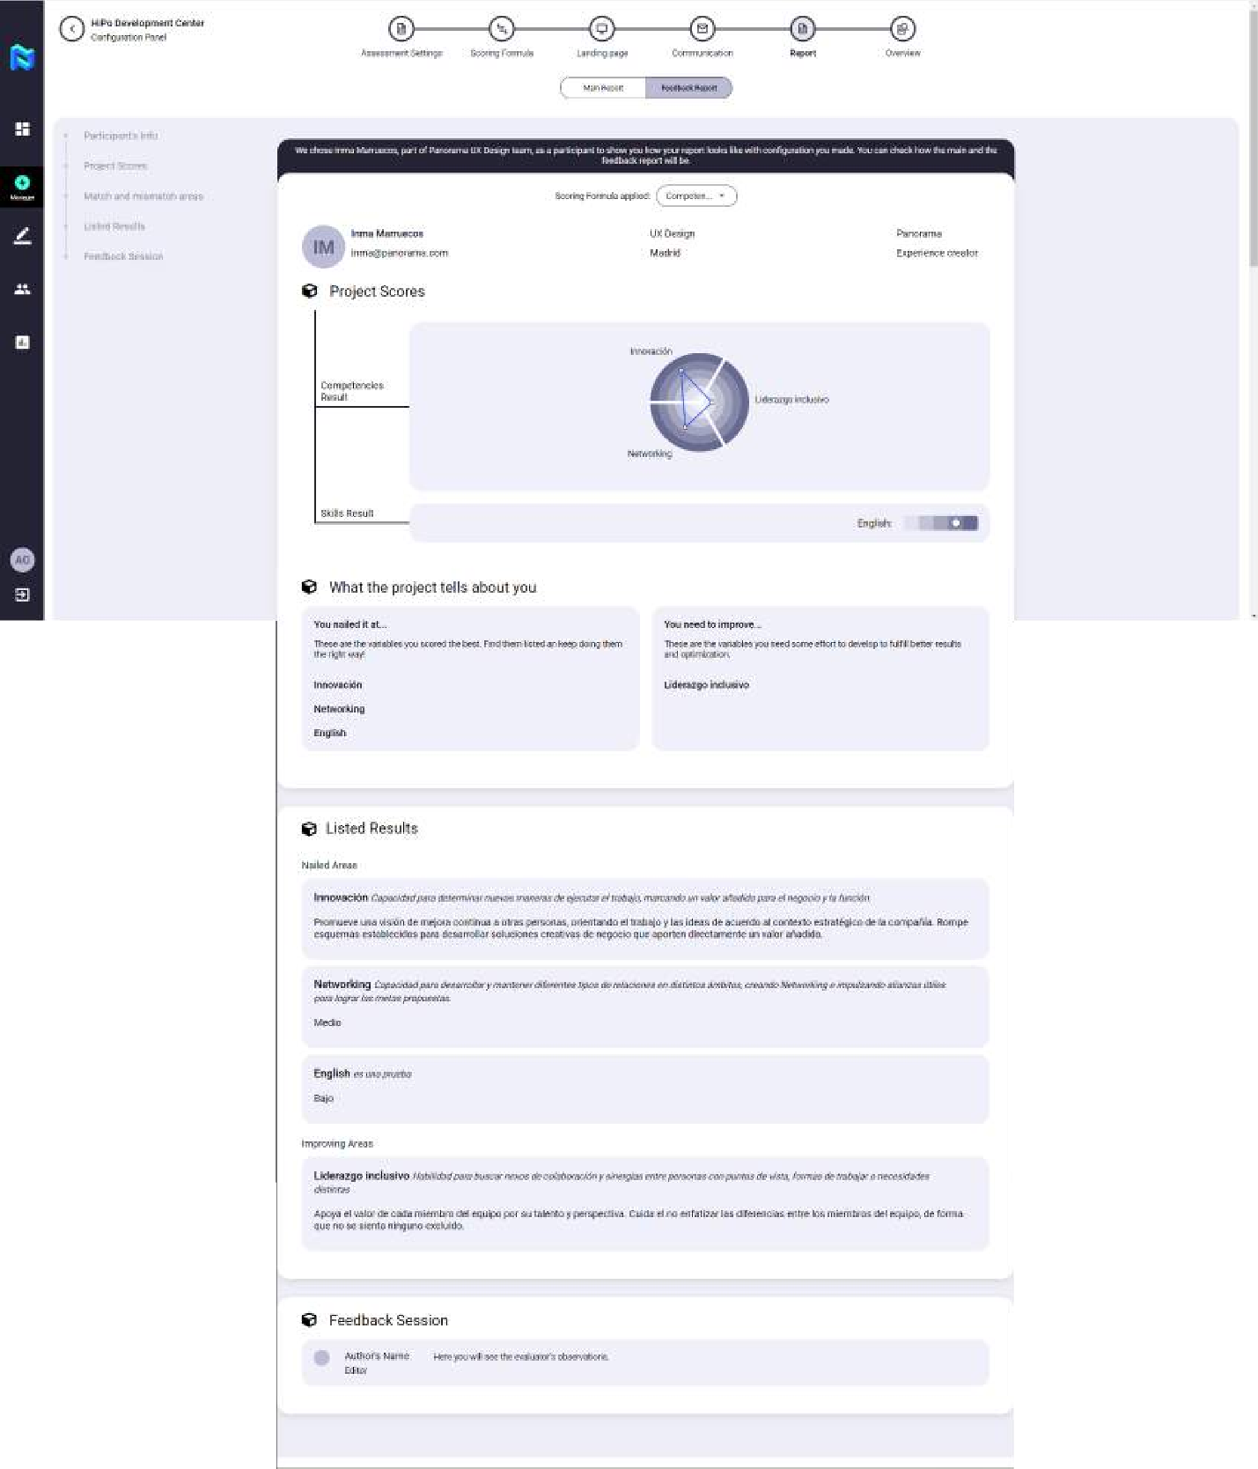
in the control panel of the Project Manager and the Advisor/ Evaluator of those participants to which he or she has been assigned.
This report does not include the scores obtained by the participant nor the adjustment to the fixed reference profile, it only gives qualitative information of the results obtained in the process.
4.7 OVERVIEW
In this section of the "journey sequence", we can download (for the client to preview) the configuration made in the project to check if any changes have to be made before launching the project. At the moment this is a functionality that is in development and is not currently available on the platform.

Slide 31
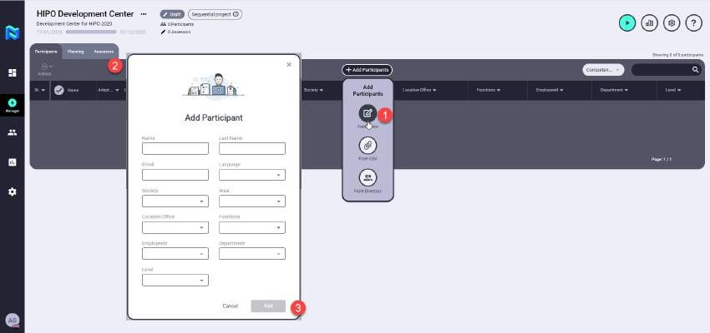
  ADDING PARTICIPANTS
To add the participants to a project in the Project manager you will have three options available to you when you press "Add Participants" button.
The three ways to add participants are: creating a new participant, from a csv. file, or from the directory where you will find all the people that have been previously uploaded to the platform.
    Create New
To add a new participant, you just have to click on the "Add Participants" button, select the "Create New" button, fill in the data that appears in the form and press the "Add" button.
4.8.2 Excel upload & participants metadata
To add a participants from a .csv file, you will have to click on the "Add Participants" button, select the "From CSV" button, select the file from its location or drag it to the document uploading area and once processed click on the "Add" button
The Excel file that can be uploaded to the project must be in .csv format, and can contain up to 10 metadata for each of the employees uploaded, the mandatory data that the file must contain are Name, Surname, e-mail, Company, Level area, Manager's ID, Manager's name, these metadata are those data by which it will be possible to filter and locate the participants.

Slide 32
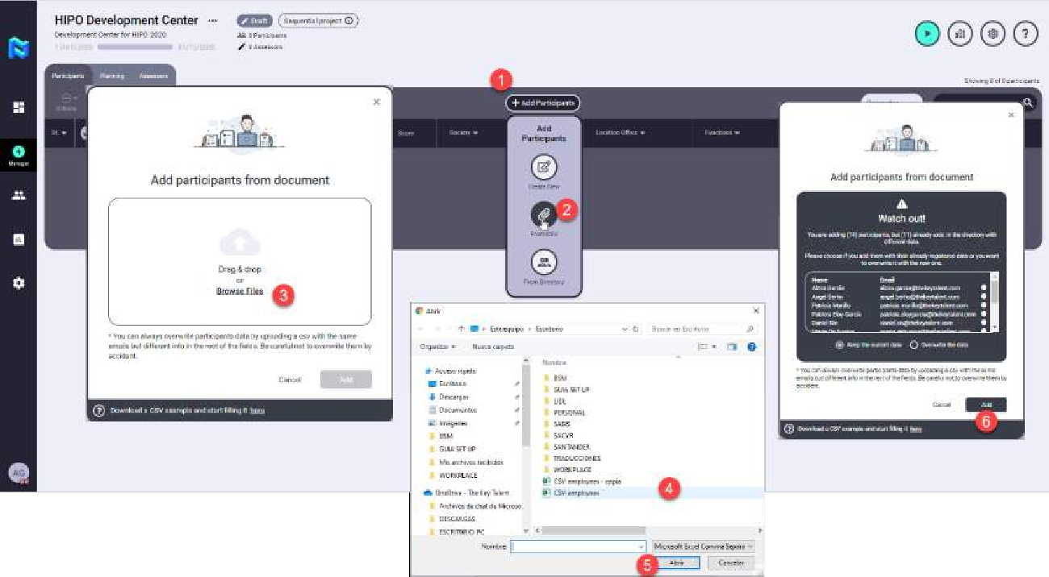
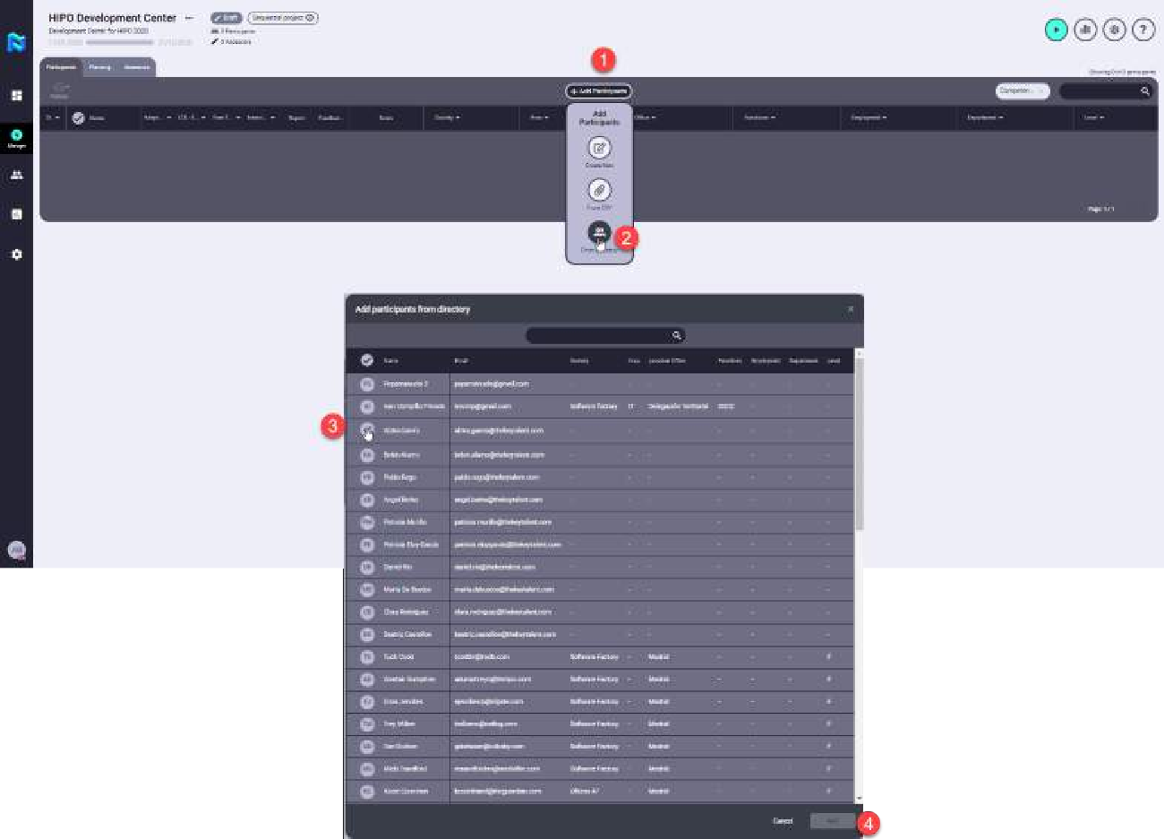
4.8.3 From the directory
To add a participant from the directory, you will have to click on the "Add Participants" button, select the "From directory" button, select the participant or participants you want to add by clicking on their avatar and click on the "Add" button.
4.9 ADDING ADVISORS
To add the Advisors/Evaluators the Project Manager must be placed in the "Advisors/Evaluators" tab and click on the "Add Advisor" button, press the "Form Directory" button and add the advisors/editors in the same way that it was done for the participants from the "From directory" option. Once the advisors/evaluators that you want to add to the project have been selected, you must click on the "Add" button.

Slide 33
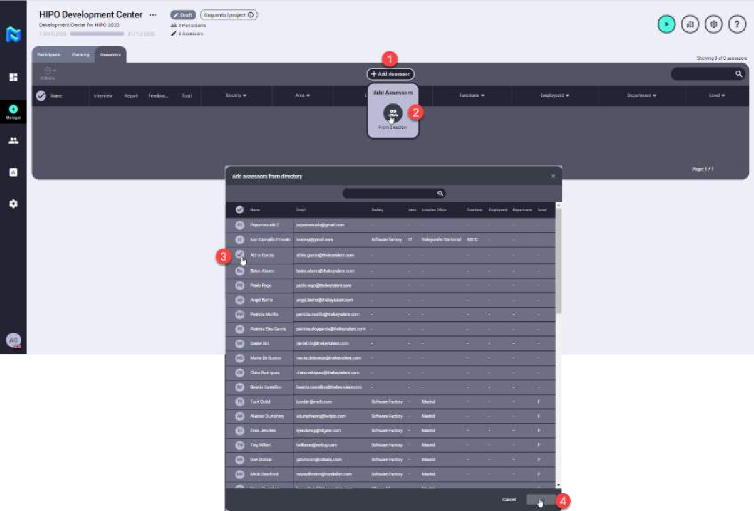

  PLANNING
To plan the tests of the participants, the Project Manager must be placed in the "Planning" tab.
The planning of the tasks that require an Advisor/Evaluator can be done in two ways, either manually for each test and for each participant or, by selecting several advisors and using the "Multiplaner" function, assign the advisors/evaluators to the participants in a massive way for each of the tests.
    One by One Planning
The Project Manager selects the participant for whom he wants to plan by clicking on his avatar, he/she selects by clicking on the "plus" icon of the test to which he wants to add the assessor/evaluator, selects the desired assessor/evaluator from the drop-down menu and clicks on the "Save" button. For all the tests of a participant to be configured you must perform this action for all those that require the participation of an assessor.
¡IMPORTANT! You are able to assign to a participant as many assessors/evaluators as you please. A participant does not need to have one sole or specific assessor. There can be a different assessor per phase.

Slide 34
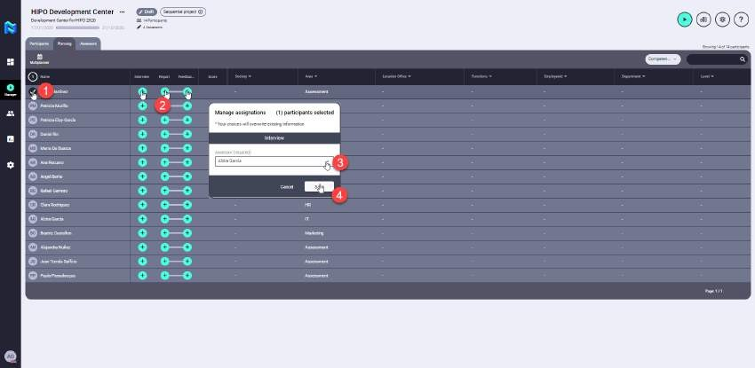
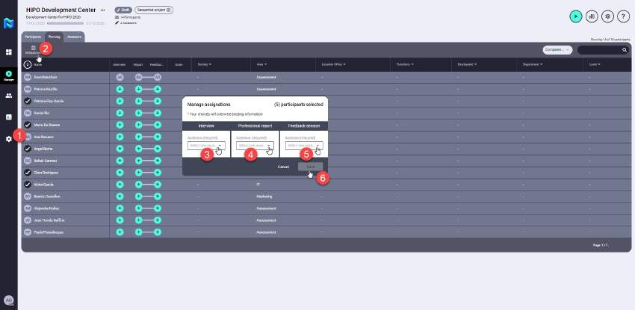


4.10.2 Multiplanner
With this option, the Project Manager will be able to select several participants and add their advisors/evaluators in bulk and for each of the tests at the same time. To do this, click on the avatars of the participants you want to plan for, then click on the "Multiplanner" button, and select the advisors/evaluators you want for each test from the drop-down menus, which can be the same in all of them or not. Finally, to confirm the selection, click on the "Save" button.
¡ALWAYS REMEMBER! You can modify the selection of any assessor/evaluator, as simply as clicking on the assessment tool and then the new assessor/evaluator.

Slide 35
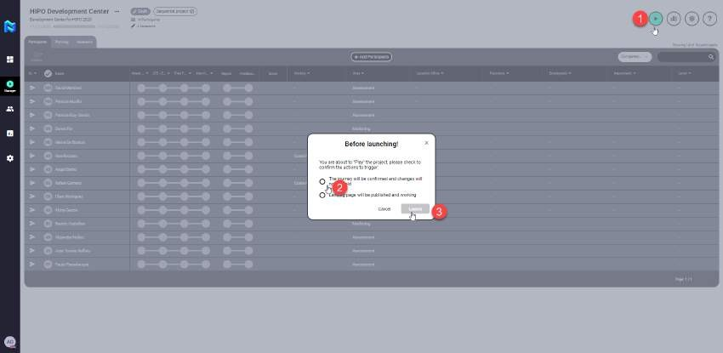
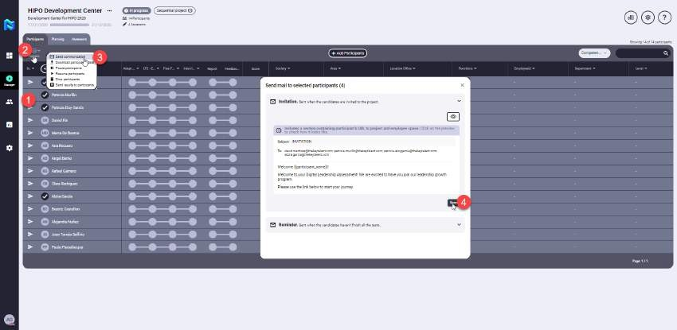
4.11 LAUNCHING A PROJECT
Once we have configured the Project and added the participants and the advisors/evaluators we can launch the Project. To do so, all we have to do is click on the "play" button and accept the recommendations we want. At this point the Project is active and we can no longer change anything in its configuration.
For the project to start, we must send the invitations to the participants manually (if we have not previously left the self-invitation check active in the communications). To do this, we select the participants we want to invite to the project at this time, press the "Actions" button, select the "Send Communication" option, select the "Invitation" option and press the "Send" button, at this time the selected participants will receive an e-mail with access to their "landing page".

Slide 36
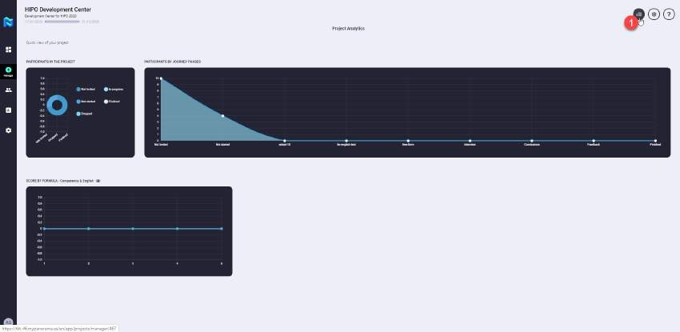
4.12 PROJECT STATISTICS
As a project advances, the Project Manager will be able to consult its statistics to check its evolution. To do so, click on the "Graph" icon in the upper right-hand corner and access the Project Graphs screen. To exit this screen, you must do the same by clicking on the "Graph" button and return to the project control screen.
  OTHER ACTIONS CARRIED OUT ON PARTICIPANTS
    Remind participant
For those participants who have not yet taken the Journey tests, managers can send an email reminder to finish their tests.
Once these participants have been located in the project, we only have to click on their "avatar" and select the "Action" button to send a reminder. This is the same procedure as when you want to send them an invitation.
    Pause a participant
Panorama allows a participant in a given project to pause on those occasions when it is required, making it impossible for him to advance in the tests of the project. This action is done by marking the participant in his avatar, and clicking on the "Actions" button, we select the option "Pause participants".
    Drop a participant
Panorama allows a participant to be locked into a particular project on those occasions when it
is required, making it impossible for him to progress with the project. This action is done by marking the participant in his avatar, and clicking on the "Actions" button, we select the option "Drop participants".
    Sharing participant's report
The platform will allow the possibility of sharing the Results Report with the HR departments, as well as with those collaborators (senior and middle management, ...) who participate in the evaluation of the participants. At the moment this is a functionality that is under development and is not currently available on the platform.

Slide 37
4.13.5 Sharing participant's report feedback
The platform allows the possibility of sharing the Comments Report directly with the participants, as long as this is desired and the message for sending the results has been configured in the communications module. To perform this action, the participant must have finished the journey of the project and can be selected by clicking his avatar, then press the "Actions" button, and select the option "Send Communication", select the option "Send Results" and press the button "Send", at this time the participant will receive an email indicating that he can consult the results of the project on the web that will redirect the link obtained in the mail.
Next, we are going to explain the operation of an Assessor/Evaluator.

Slide 38
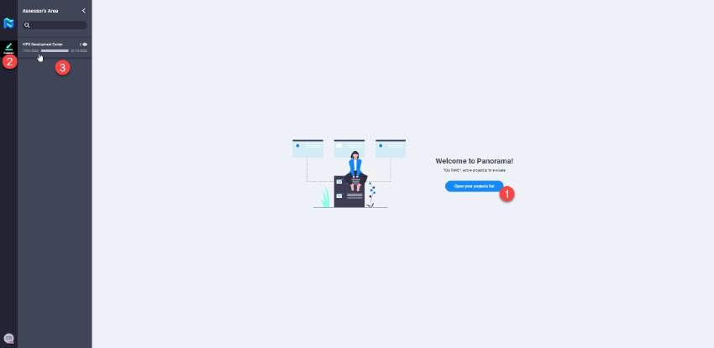
ASSESSOR
An assessor or evaluator of a project is the person in charge of conducting the Interviews of the participants and the Report of Results that is given to HR as well as the Report of Comments that is given to the participants at the end of the project (of those participants to whom he has been assigned as a consultant/evaluator for some or all of these tasks).
Once the Project Manager has assigned to the Assessor/Evaluators those participants to whom he/she must evaluate in a specific Project, the Assessor/Evaluators will be able to access the platform and in his/her Advisor space consult all those projects to which he/she has been assigned, as well as the tests on which he/she has to act for each participant.
  INTRODUCTION
As soon as you access the platform you will find a welcome message from the Assessor/Evaluator indicating the number of projects in which you have to carry out some action. From there you can access your list of projects and by clicking on each one of them you can consult the participants and the actions you have to carry out on them.
When accessing a specific project, those phases in which the Assessor/Evaluator has to intervene are highlighted in the header.
5.2 SCHEDULING INTERVIEWS
To schedule interviews with the participants, the Assessor/Evaluator must have created an account on https://calendly.com/ linked to his/her e-mail service so that the participants can select from the "free spaces" previously selected by the Assessor/Evaluator, which is the most convenient for them to conduct their interviews.
Therefore, in order to schedule interviews, the Assessor/Evaluator must first select the available time slots in his/her https://calendly.com/ account, and then copy the link. Once this step has been carried out, he/she will return to Panorama and will click on the "Calendar" icon located in the upper right-hand corner of the project control screen and will copy the calendar link in the box provided for this purpose in the dialogue window, and finally he/she will click on the "Publish calendar" button, so that the participants assigned to it have access to their calendar and can reserve the desired date.

Slide 39
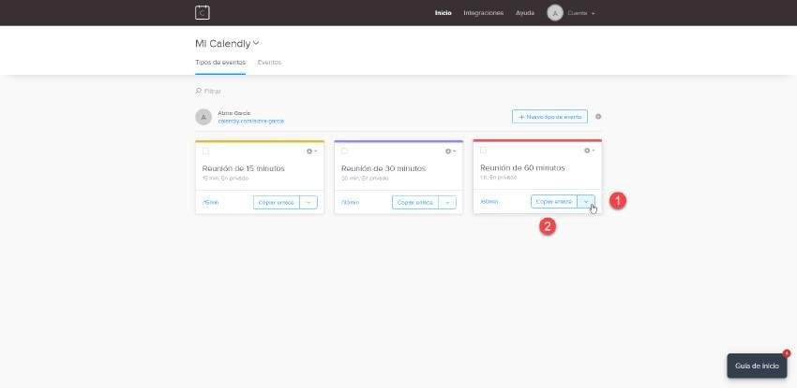
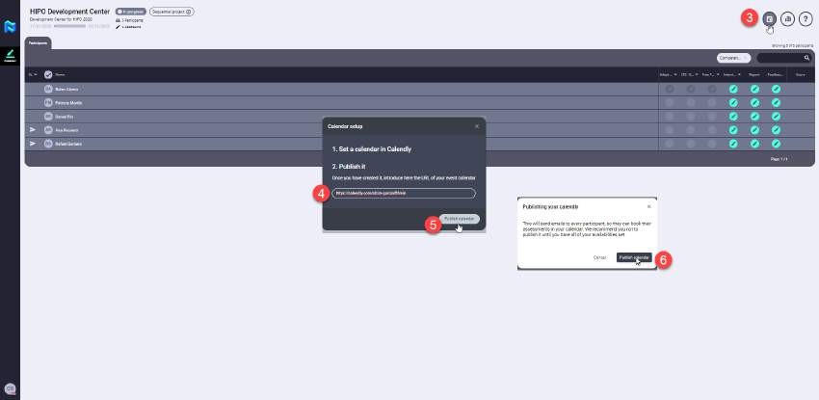
5.3 CONDUCTING INTERVIEWS
An assessor/evaluator may not conduct the interview of a participant until the participant is in the interview phase. To do so, the check must appear on the test prior to the interview so that the interview can be conducted.
Even though the participant is not in the interview phase, the Assessor/Evaluator can take notes that will be added later to the candidate profile, if the interviewer so wishes to add them to the "Observation Sheet" and save it to make the final interview report by clicking on the "Save as a draft" button. This procedure can also be done during the interview phase as a notebook for the interviewer to later help him/her make the final interview report, which he/she will fill out on the "Evaluation Sheet".

Slide 40
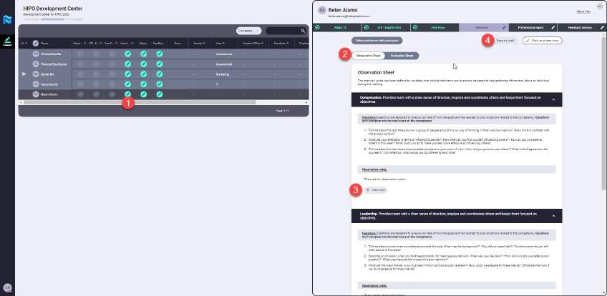
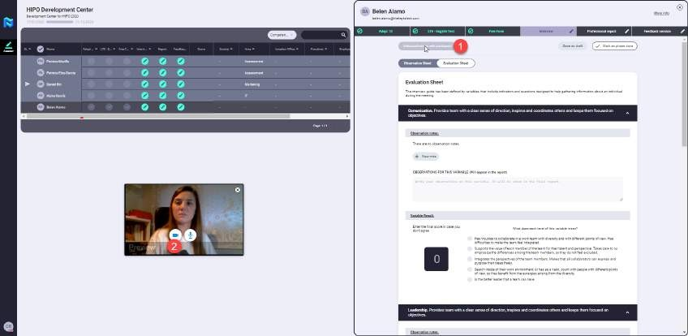
Once the assessor/evaluator is going to conduct the interview on the date selected by the participant, he/she will click on the icon of the participant's interview and when the side screen with the "Observation and Evaluation Sheets" opens, he/she will click on the button "Videoconference with participant", at that moment an e-mail will arrive to the participant to join the interview room.
The assessor/evaluator may record the interview session so that it can be reviewed later to create the "Evaluation Sheet".
Once the "Evaluation Sheet" is completed, the participant must click on the "Phase done" button so that he/she can move on to the next test of his/her journey. If the interview is the last one phase, so that the "Results Report" phase is activated.

Slide 41
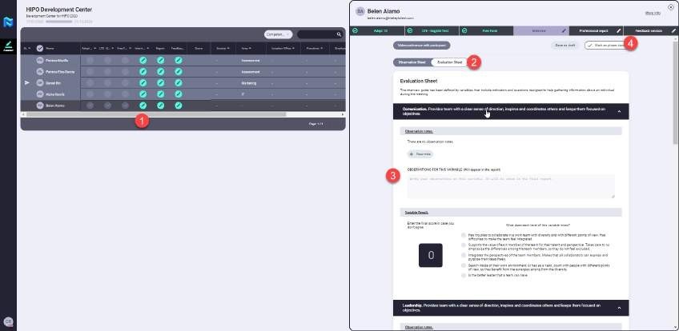
  REPORTING
There are two types of reports to be made by an assessor/evaluator in addition to the interviews that we have previously seen completed, these reports are:
    Results Report →This is the report that is delivered to HR and if desired also to the participant's manager, with all the quantitative information obtained by the participant throughout the project.
    Comments Report → This is the report that the participant will be able to consult
via the web and that includes all the qualitative information, that is to say, without numerical results, of what has been obtained in the process of carrying out the project, as well as the comments that the consultant/evaluator has made in the same.
5.4.1 Results Report
To carry out the Results Report the consultant/evaluator must click on the "Report" icon of the
selected participant and fill in the "Conclusions" box. Once he has finished filling in the report, he must click on the "Phase done" button. If he wants to finish filling in the report later, he can click on "Save as a draft", this way he/she can finish filling in the final conclusions later before marking this phase as finished. This is the penultimate phase of the project before its completion.

Slide 42
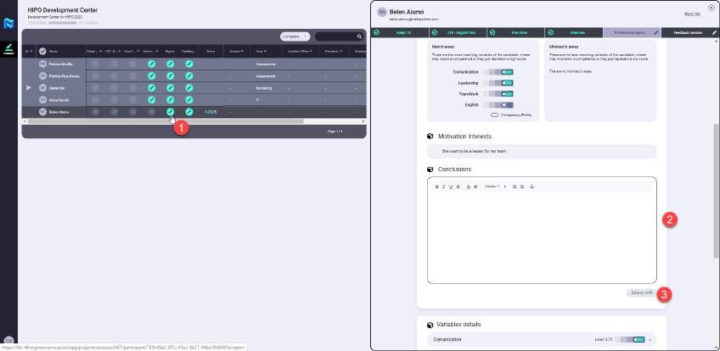
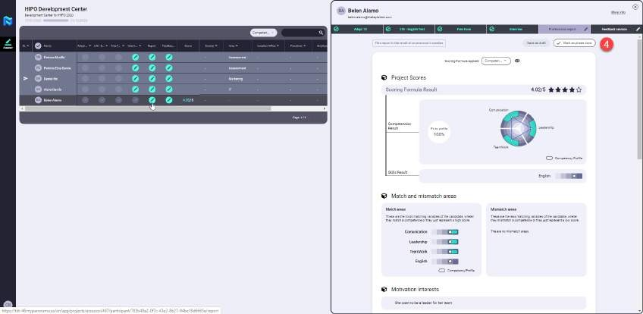
5.4.2 Comments Report
In order to carry out the Results Report, the consultant/evaluator must click on the icon
"Feedback" of the selected participant and fill in the box "Feedback Session". Once he has finished filling in the box, he must click on the button "Phase done" or if he wants to finish filling in the box later on "Save as a draft", in this way he can finish filling in his conclusions later on before marking this phase as finished.
Once this phase is marked as completed, the participant's journey will be over and therefore the project in which he was participating, and it is at this point that the results can be shared with the participant.

Slide 43
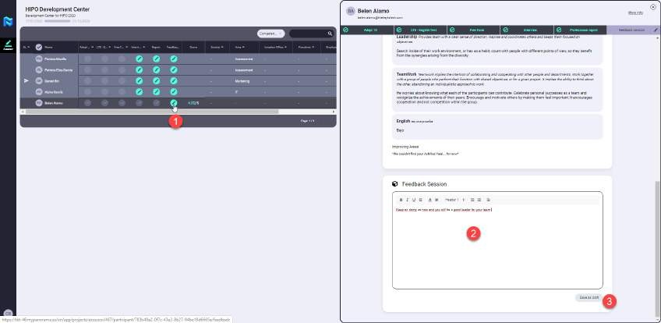
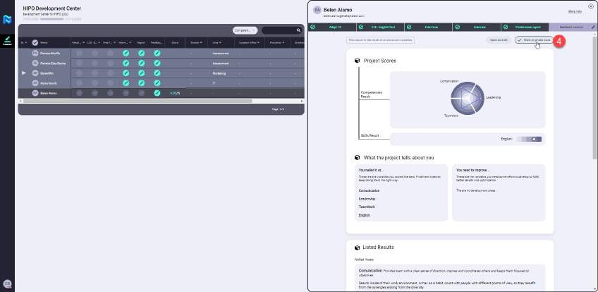

Slide 44
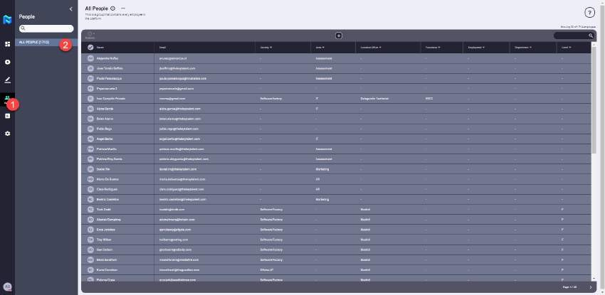
6. PEOPLE
This is the list of people who are loaded within the platform, in the future by clicking on each of the people on this list we can consult their employee information, as well as all information associated with all the results obtained within the projects in which they have participated previously. This last functionality is under development, so it is not currently available in the platform.

