Slide 1
Panorama Toolkit

Slide 2

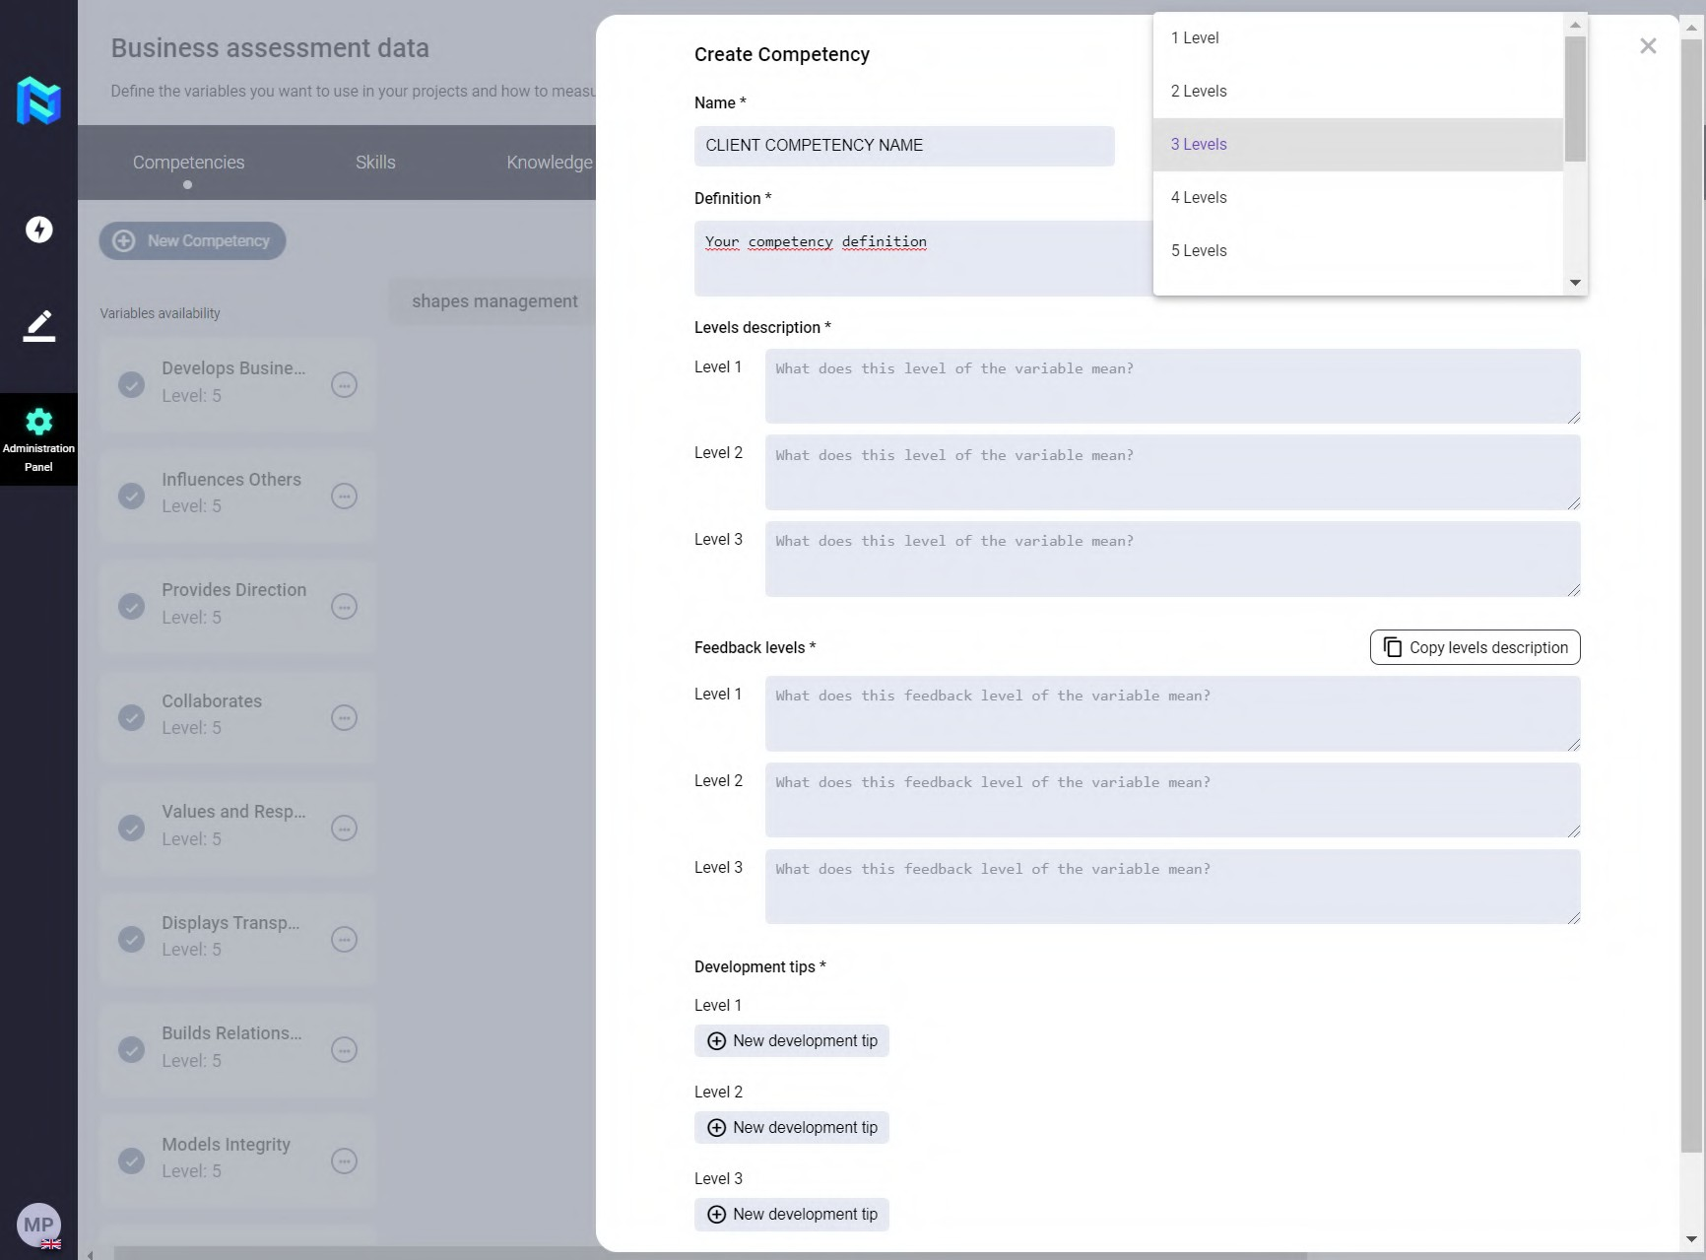
Easy Project creation for HR people
Customer Competencies Dictionary
Panorama speaks your own language, i.e. you can enter your own dictionary of skills, knowledge, abilities, values, and so on.

Slide 3

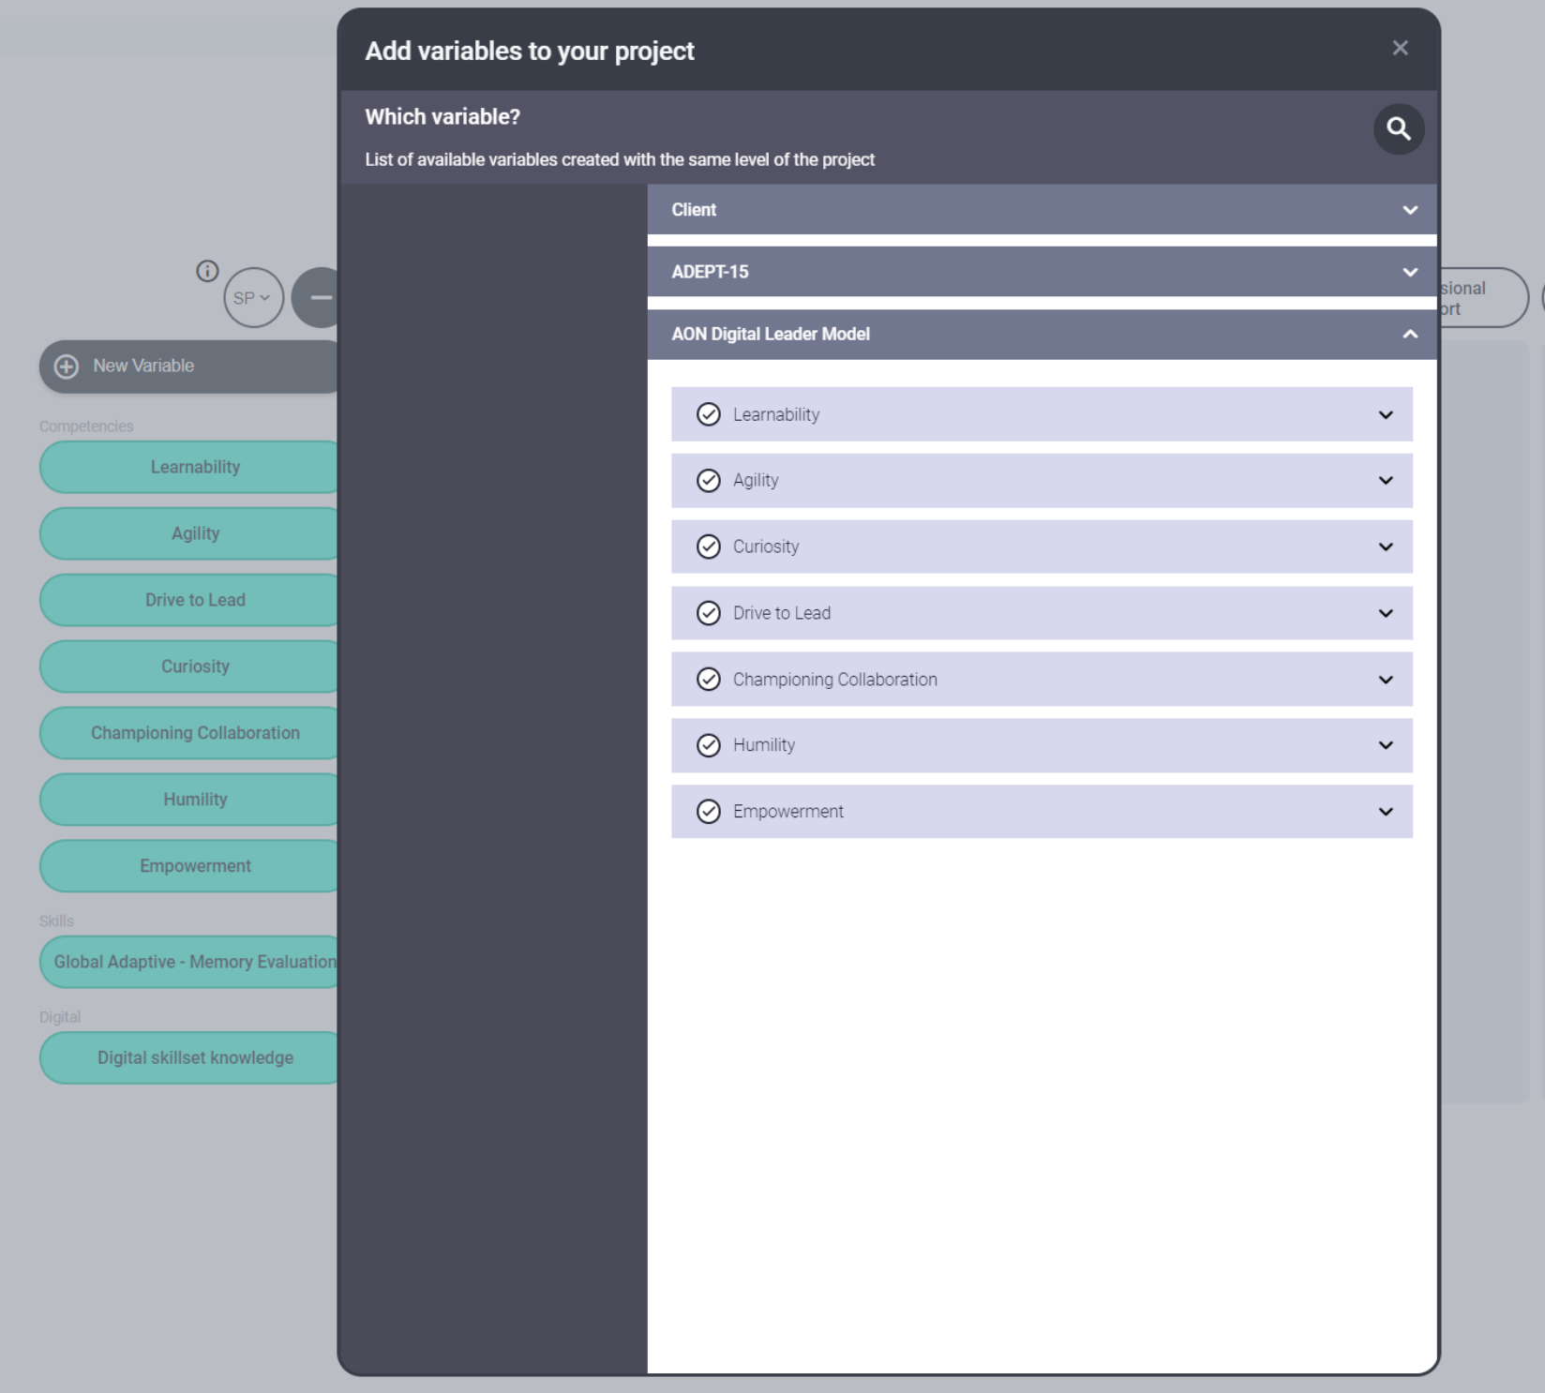
Easy Project creation for HR people
ADEPT-15 or Digital Leader Model Library
Or you can use the competence models already integrated in the platform such as Adept-15, Digital Leader Model or Shapes.

Slide 4

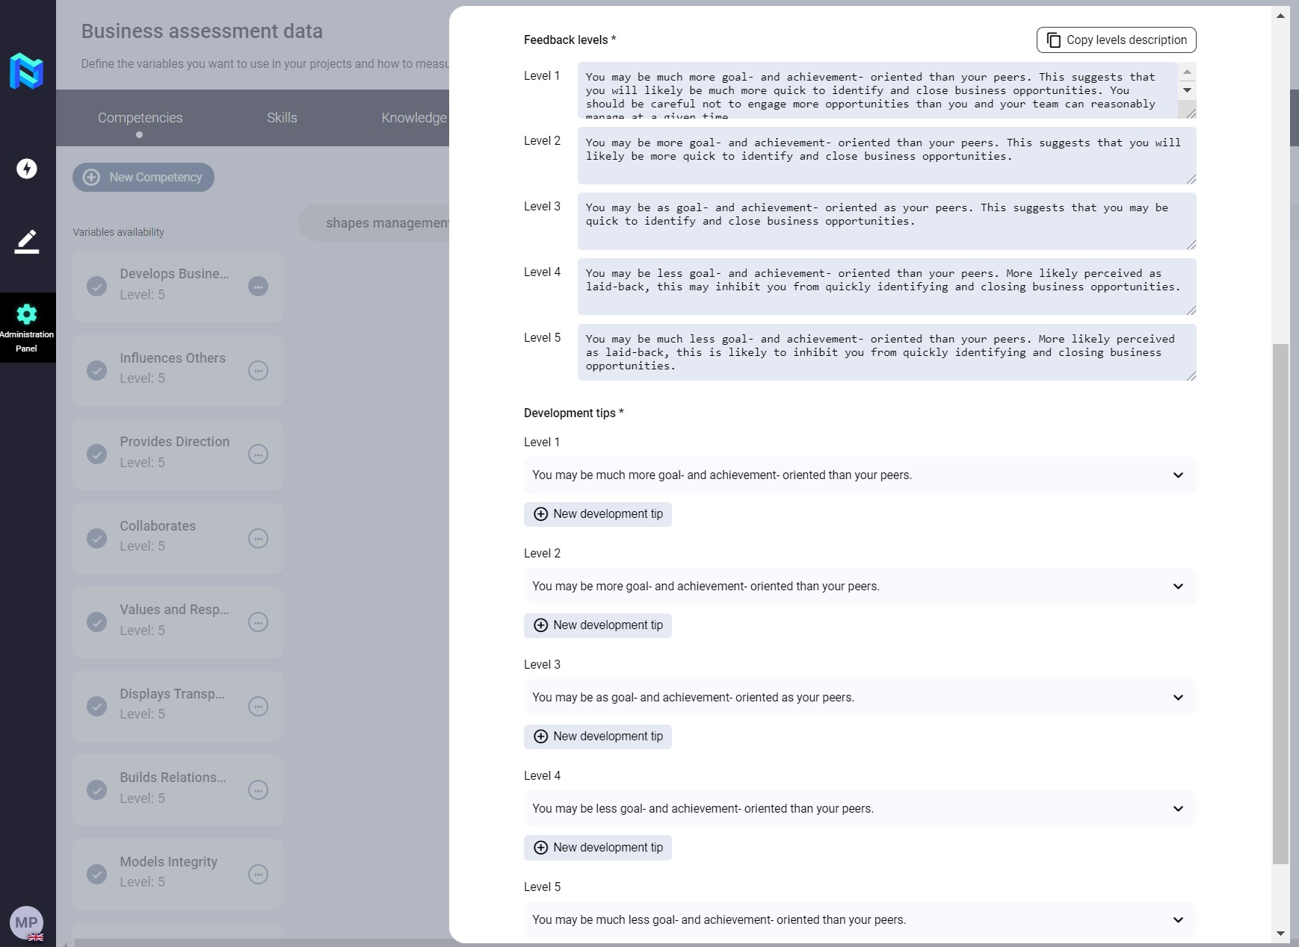
Set Development tips by feedback levels
You can define each of your recommendations for development by levels. They will appear in the feedback report that will be sent or given to the participant.

Slide 5

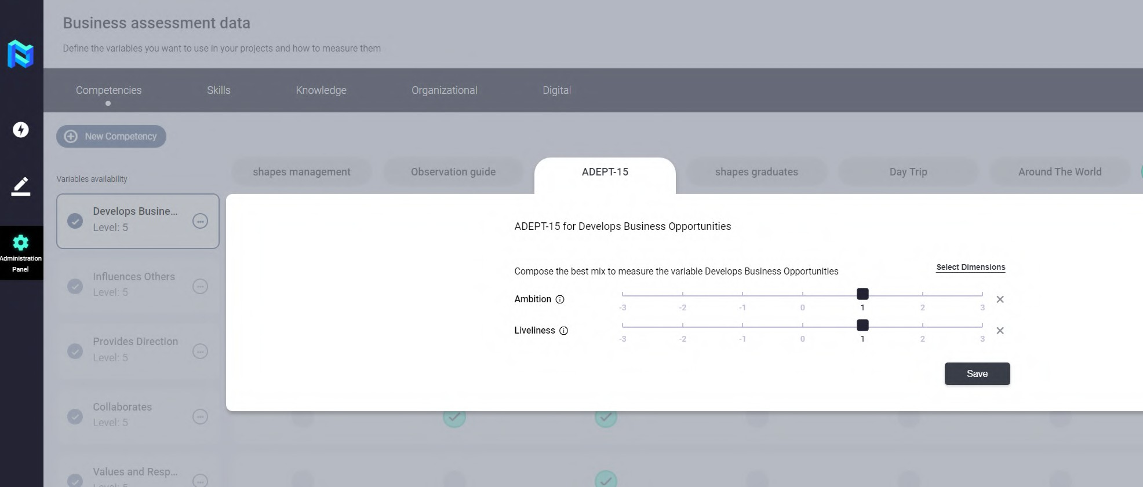


Match competency/ skills/ knowledge with tools and upload interview questions/ indicators
You can map quickly and easily your variables with the tools that are integrated into the platform.

Slide 6

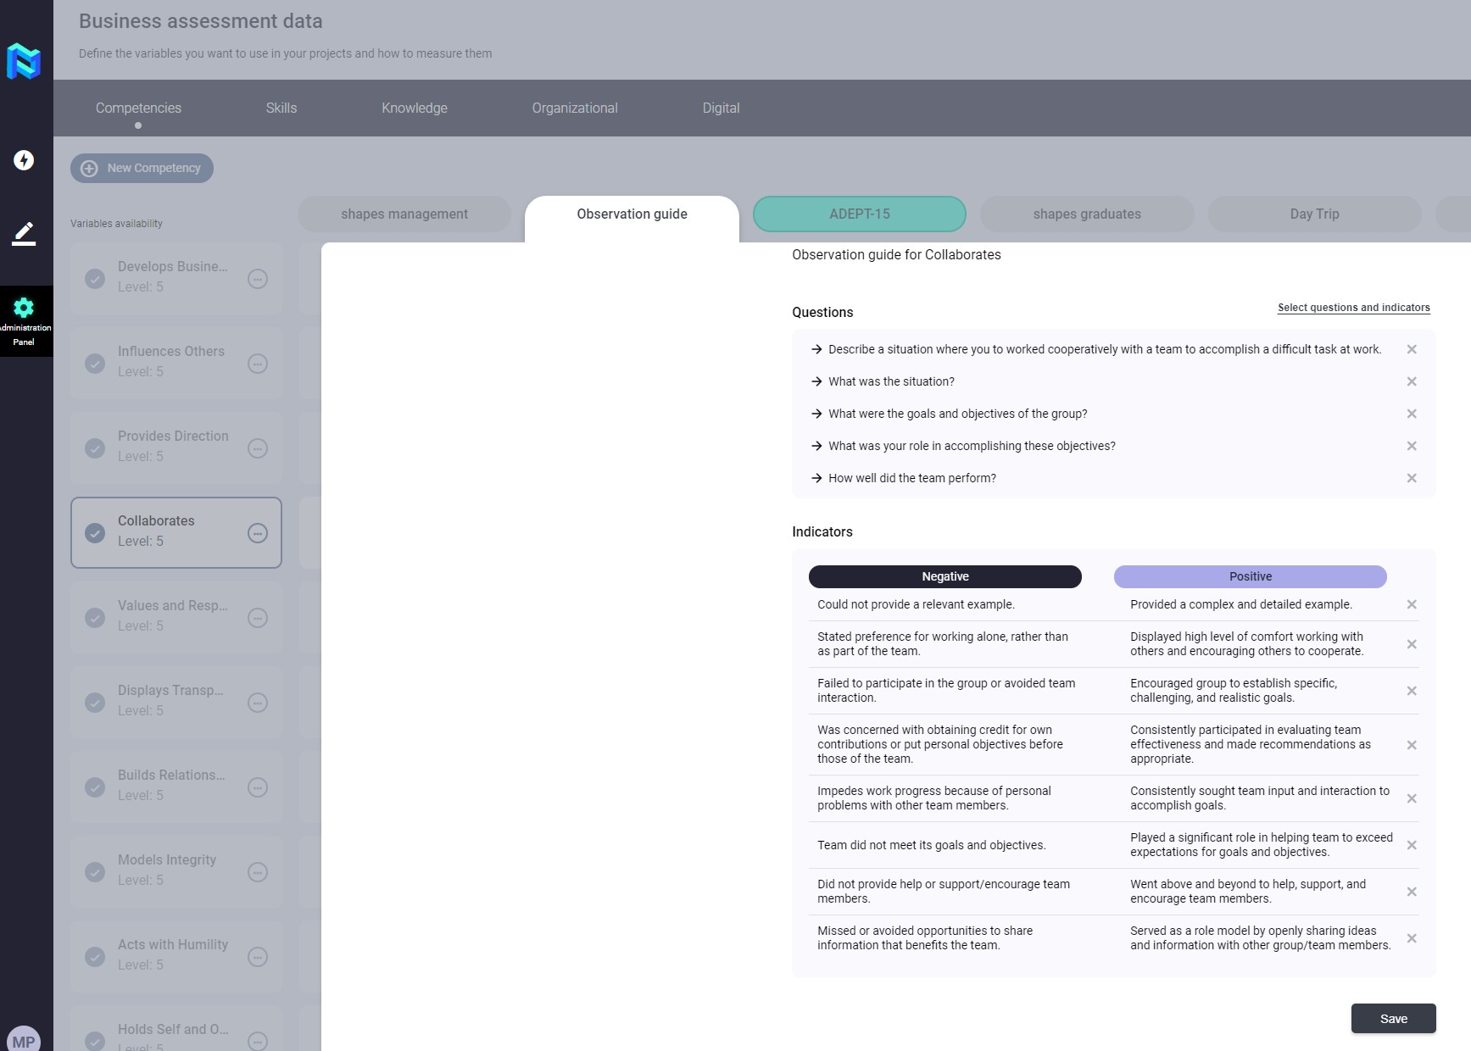
Match competency
/ skills / knowledge with tools and upload interview questions / indicators
You can upload your own interview guides and behavioral indicators to make them available for the assessment of participants.

Slide 7

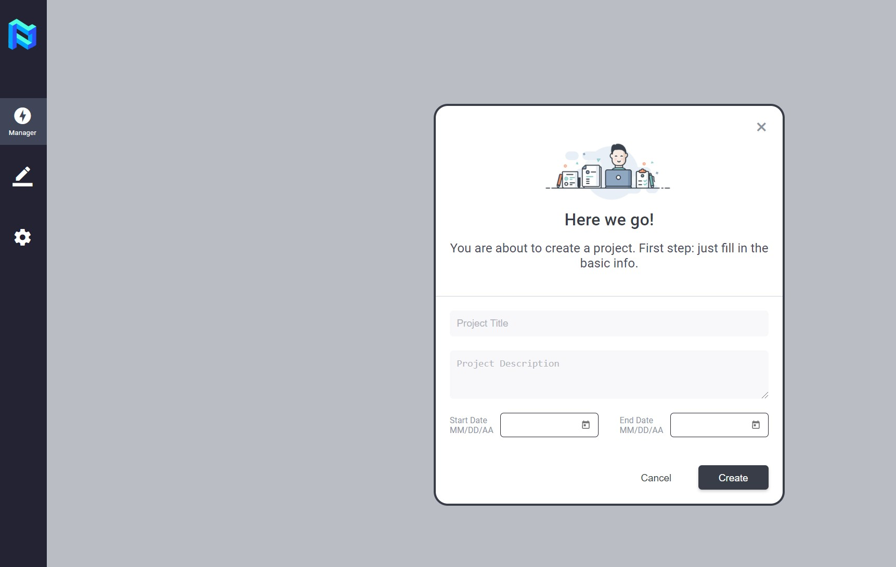
Project set up
Name your project
Define your project easily with a name, description and start and end dates.

Slide 8

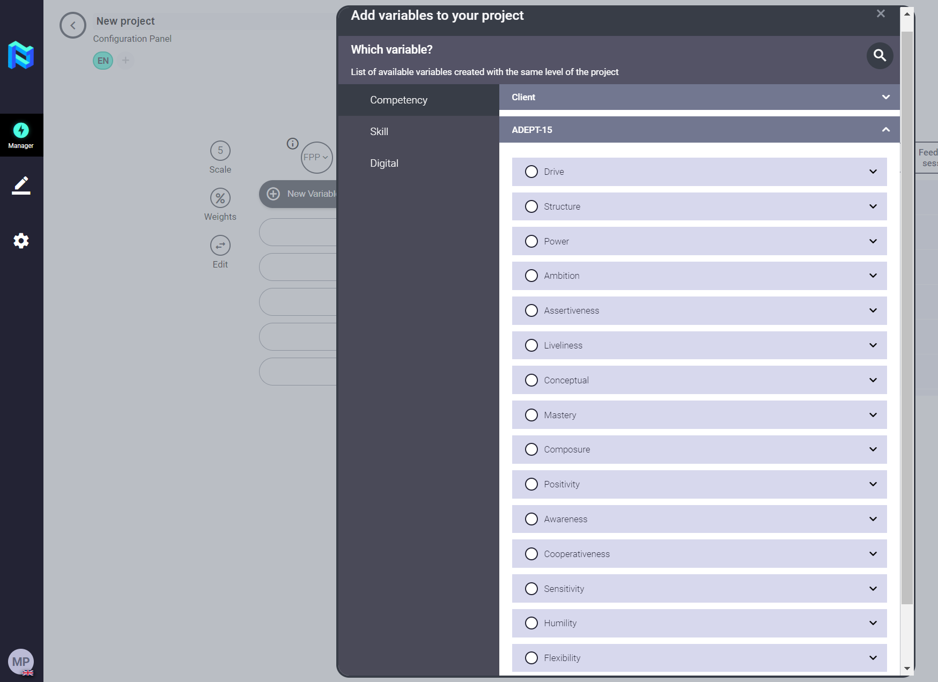
Project set up
Add competencies / skills / knowledge
Set up your Project quickly by adding the variables you previously defined, or by selecting the preloaded skill libraries in Panorama.

Slide 9

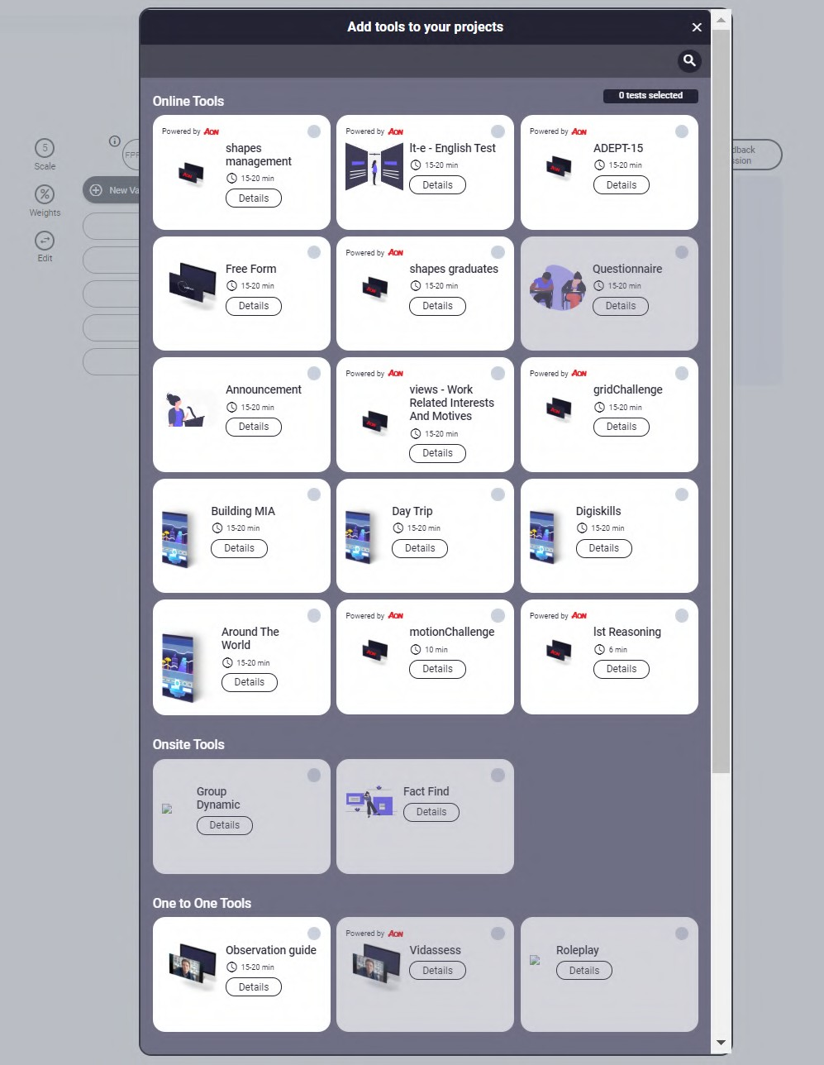
Project set up
Select tools to evaluate from AON and The Key Talent portfolio (Adept 15, Grid Challenge, VidAssess, Case studies, Role Play, interview, etc.)
Select your own or third party tools to evaluate the selected variables.
Panorama allows you to integrate your own tools to have them available in the market.

Slide 10

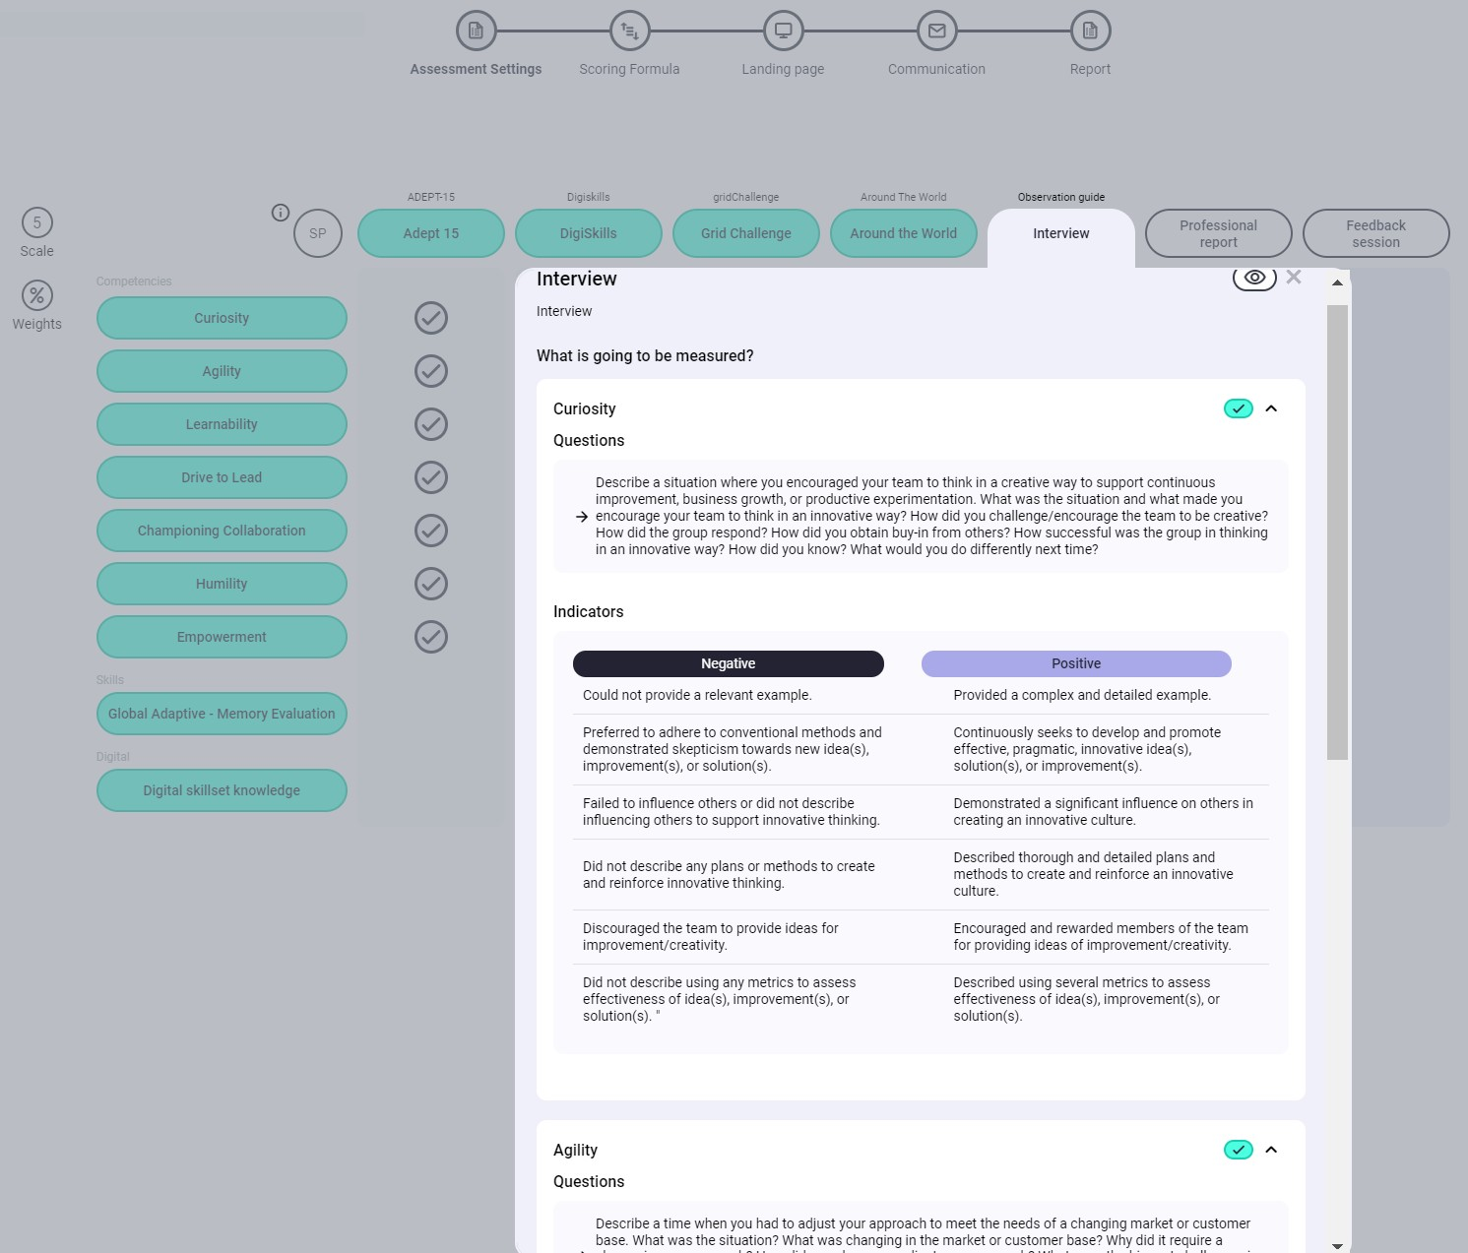
Project set up
Select your interview guide (preloaded questions and indicators)
Customize your interview guides based on the questions and behavior indicators that you previously defined on the platform.

Slide 11

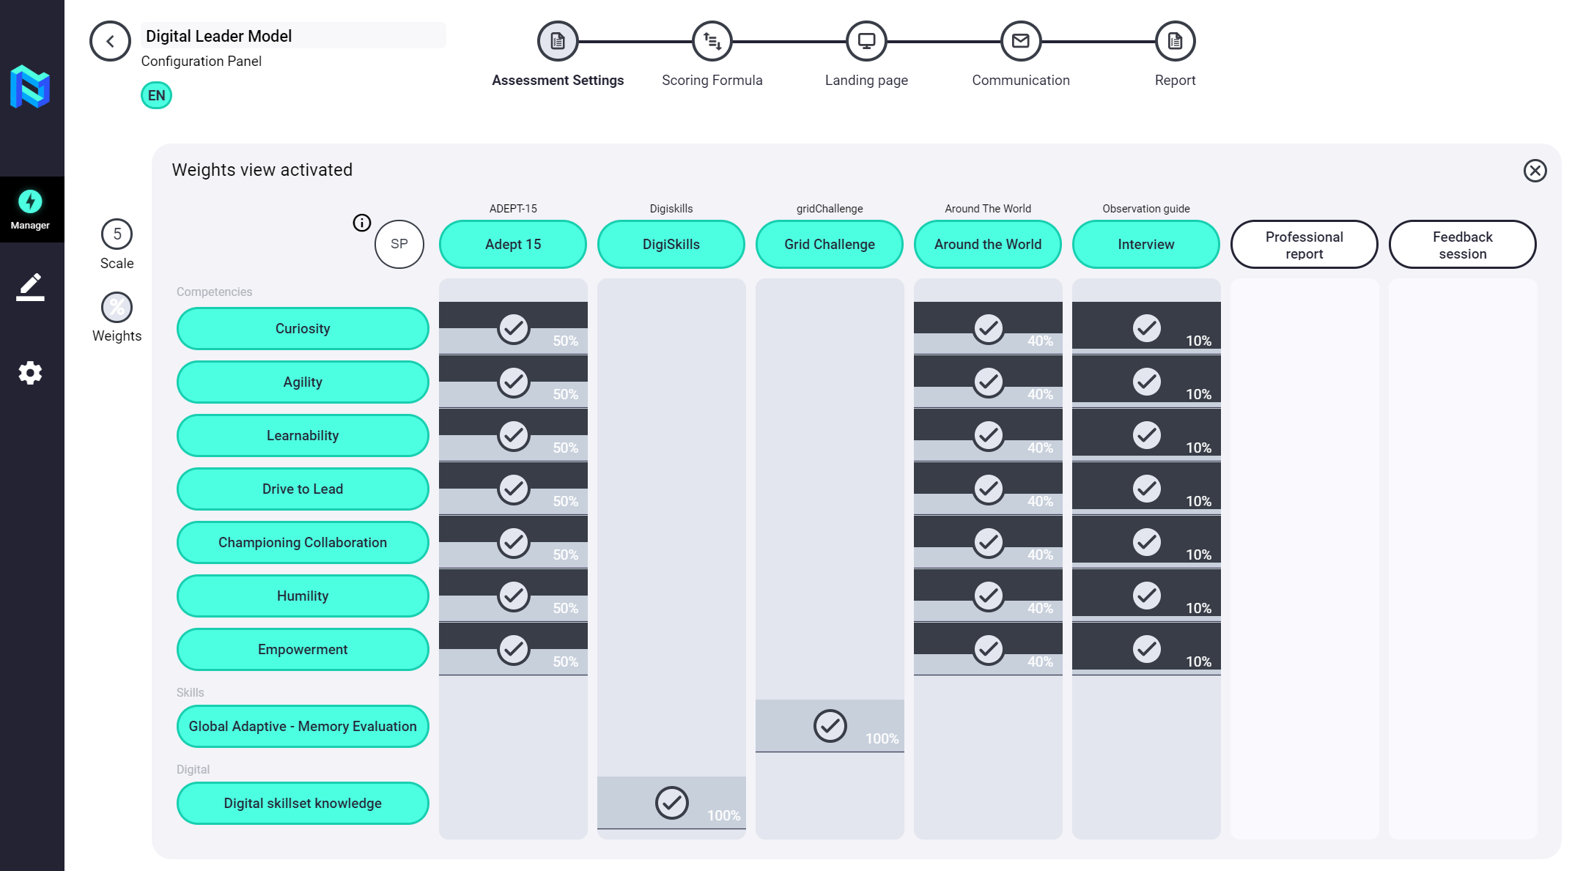
Project set up
Assign weights
Assign to what extent you want each tool selected for a variable to measure it, assigning a percentage/ weight to it.

Slide 12

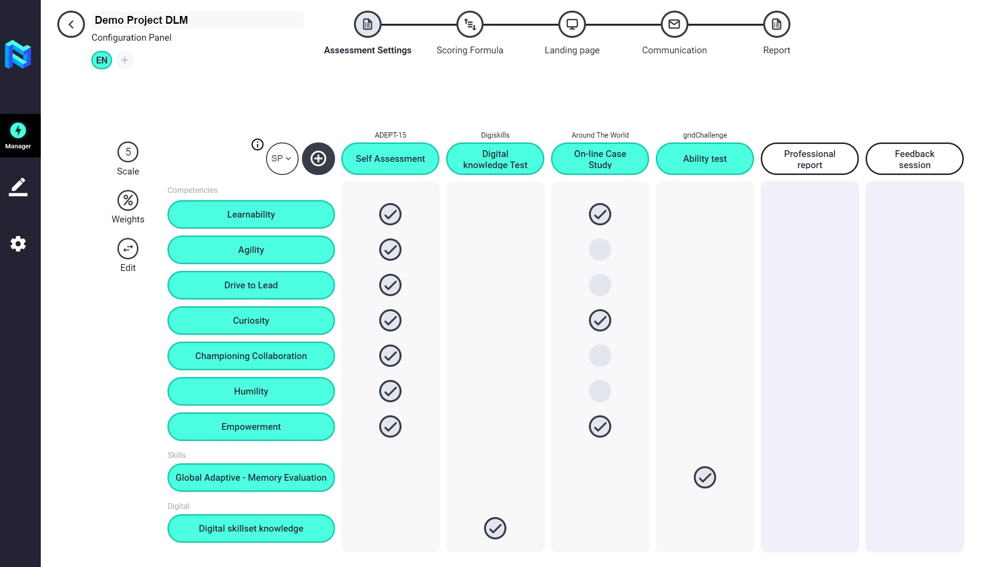
Project set up
Edit journey and customize titles
Customize the name of the tools that will evaluate your participants so that their journey is attractive.
Modify the position of the evaluation tools to best adapt the participant's journey to the process.

Slide 13
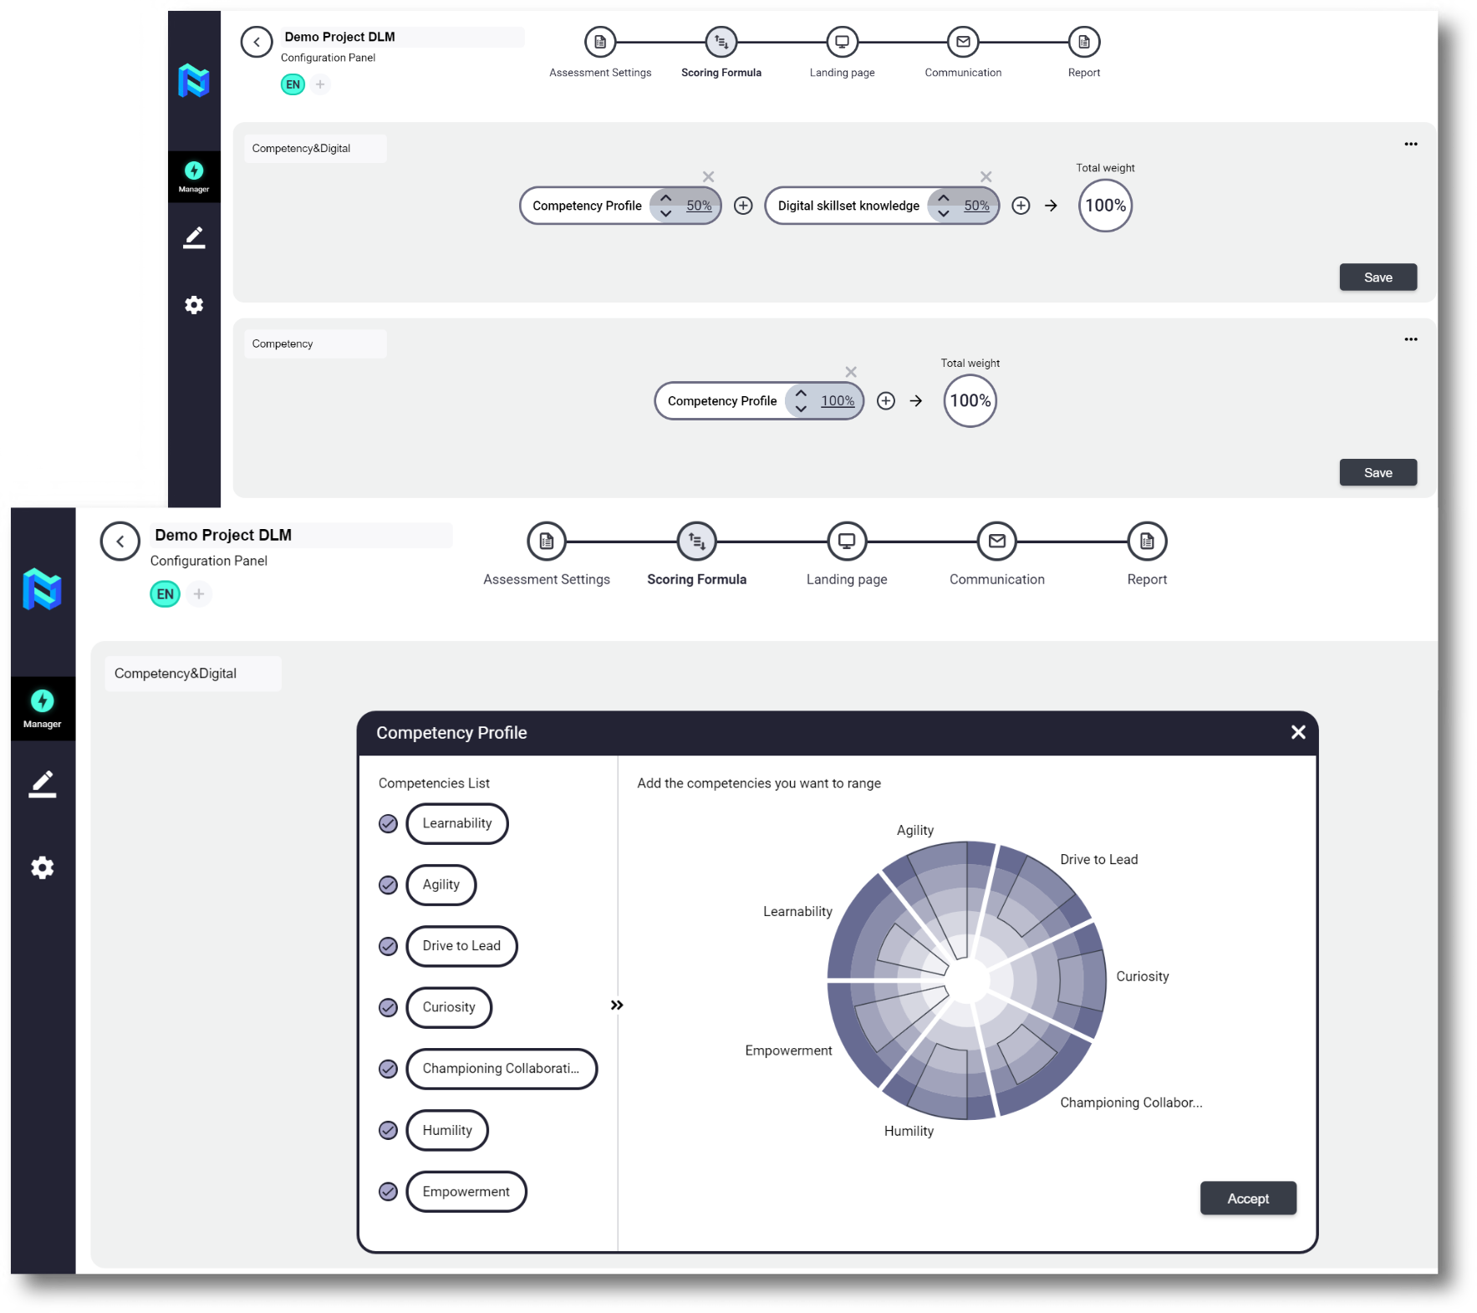
Scoring formula: Build your ideal profile
Build as many reference profiles as you want, to be able to match your participants with them.
Select the variables you want to compare as well as the competencies that will be the base of the reference profiles.

Slide 14
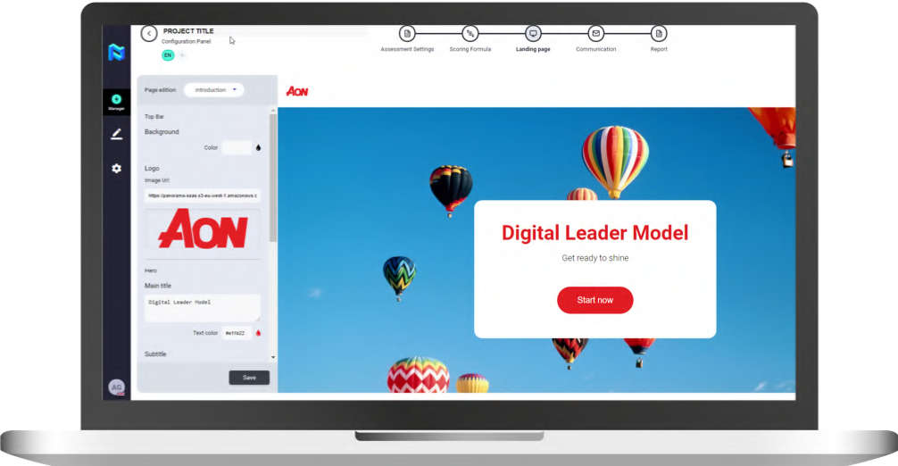
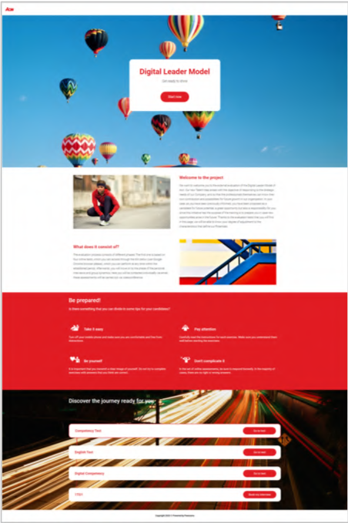
Build your own landing page (colours, logo, content, images, and so on)
Customize your Landing page with your corporate colors, logo, and company text and messages.
Use the Landing Page Builder to help your participants understand the process they have been invited to.

Slide 15
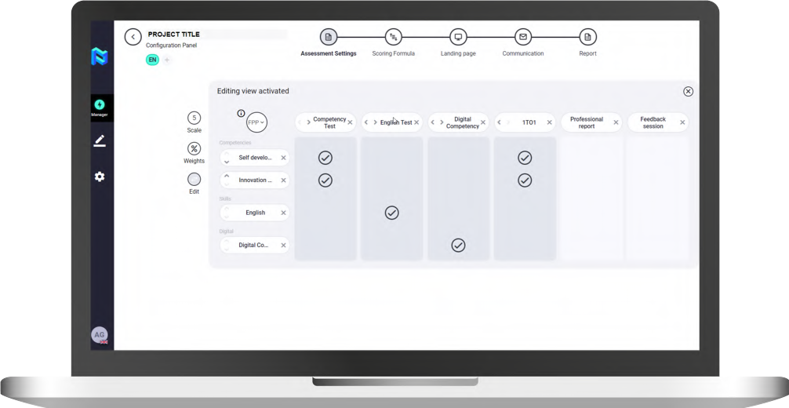
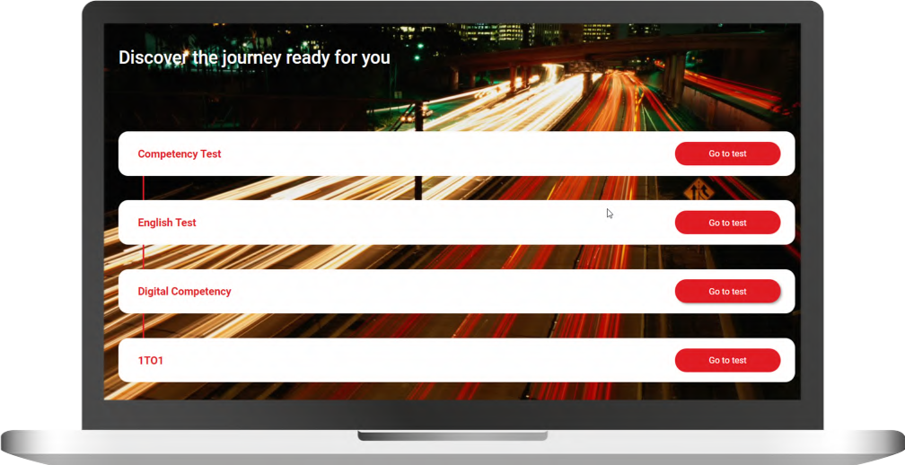
Journey will be automatically created
As you create your Project, it will automatically design the journey that the participant must follow.

Slide 16
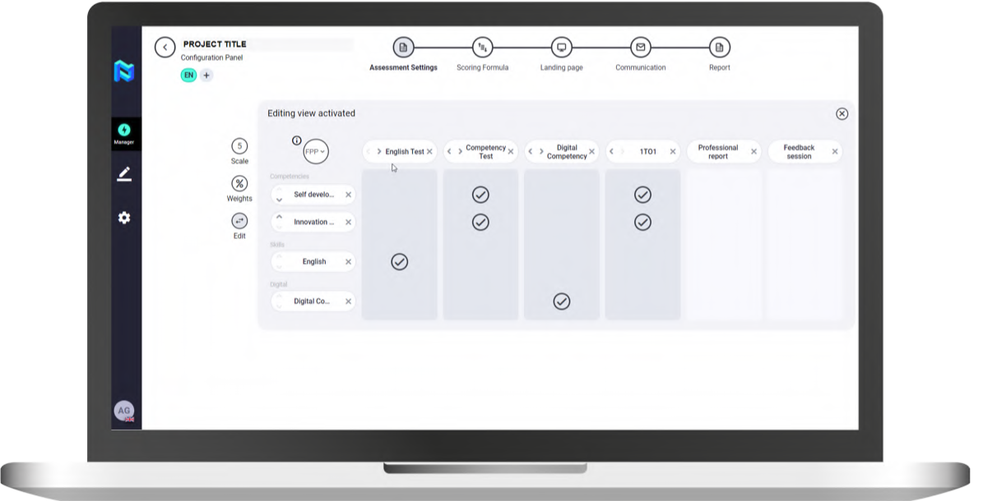
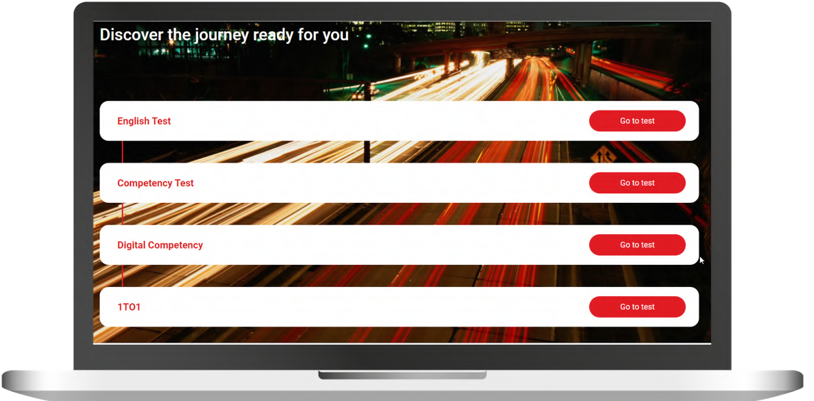
Journey will be automatically created
It is so flexible that just by changing the position of the evaluation tools, the participant's landing page journey will also be automatically updated to fit your process as closely as possible.

Slide 17
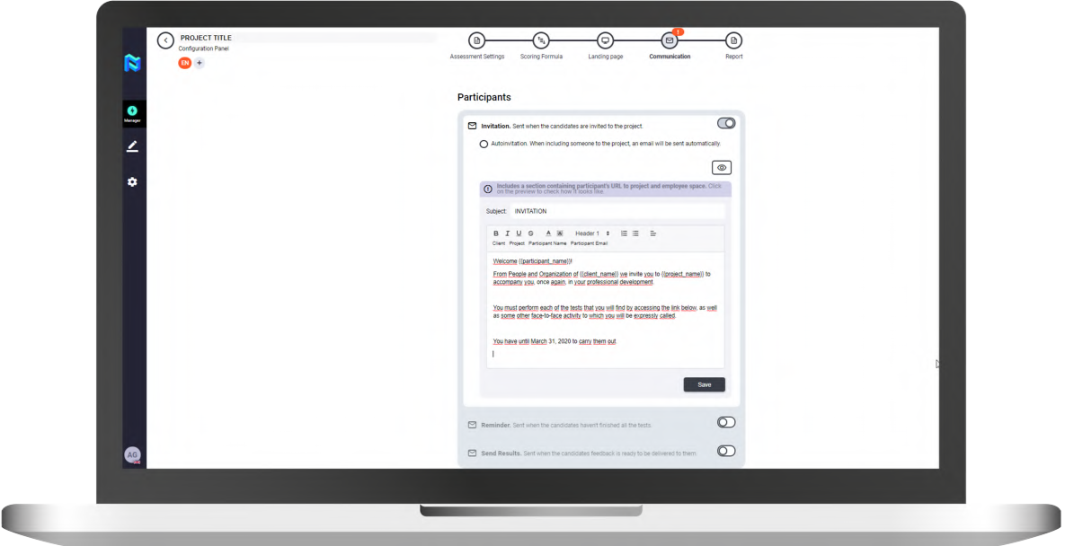
Communicate with participants through Panorama: email invitations/ reminders
Easily customize your invitation/ reminder messages and send results to your participants through the integrated Communications module of the platform.

Slide 18
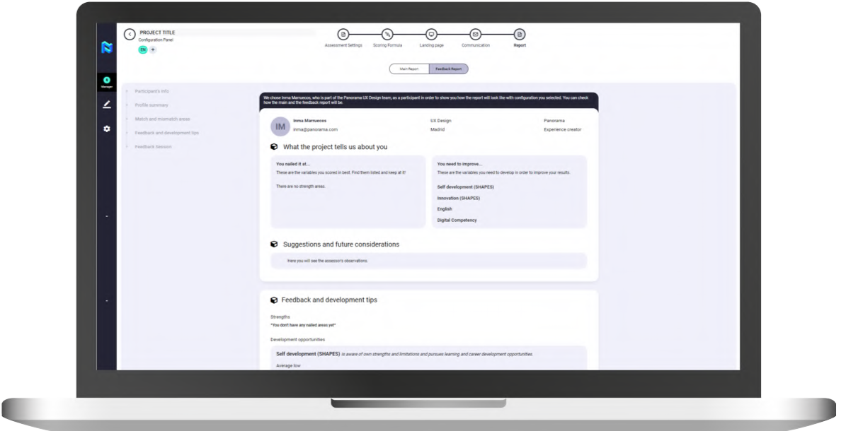
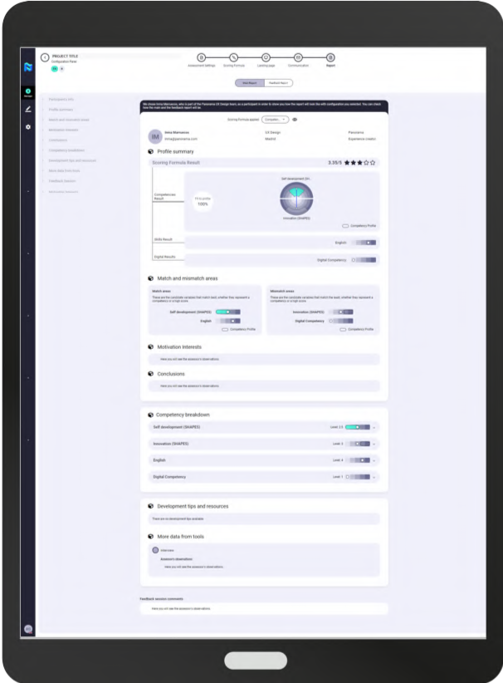
Generate report template
Once the competence- tests matrix and the reference profiles have been configured, you will be able to automatically visualize a template of how the Results Report and the Feedback Report will look like, which will be given to the participant.

Slide 19

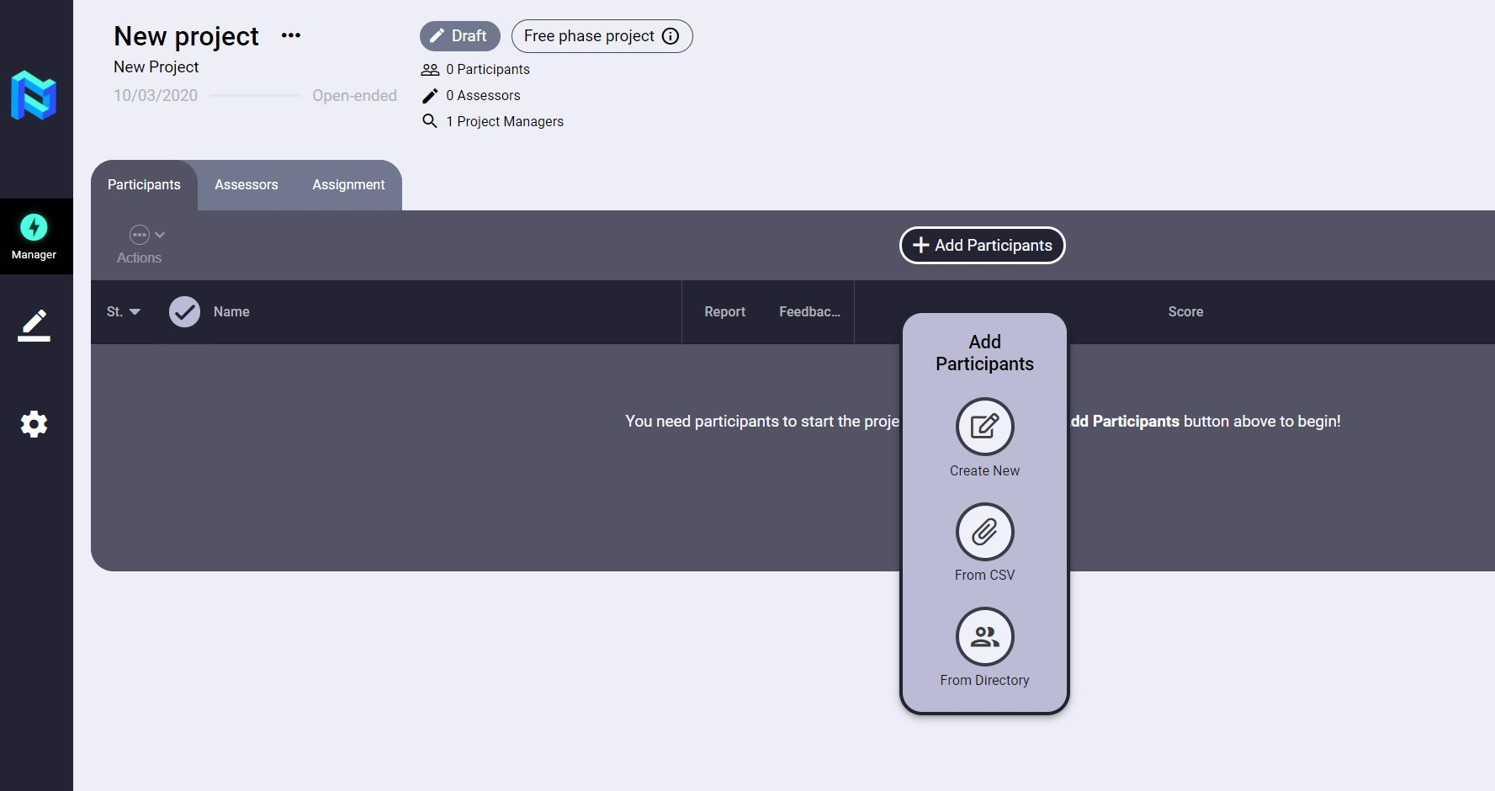
Add participants (one by one, CSV, directory)
Add participants to the Project quickly and easily through one of the three methods included in the platform.
One by one, filling out the form.
By means of a CSV file. From the Panorama People

Slide 20
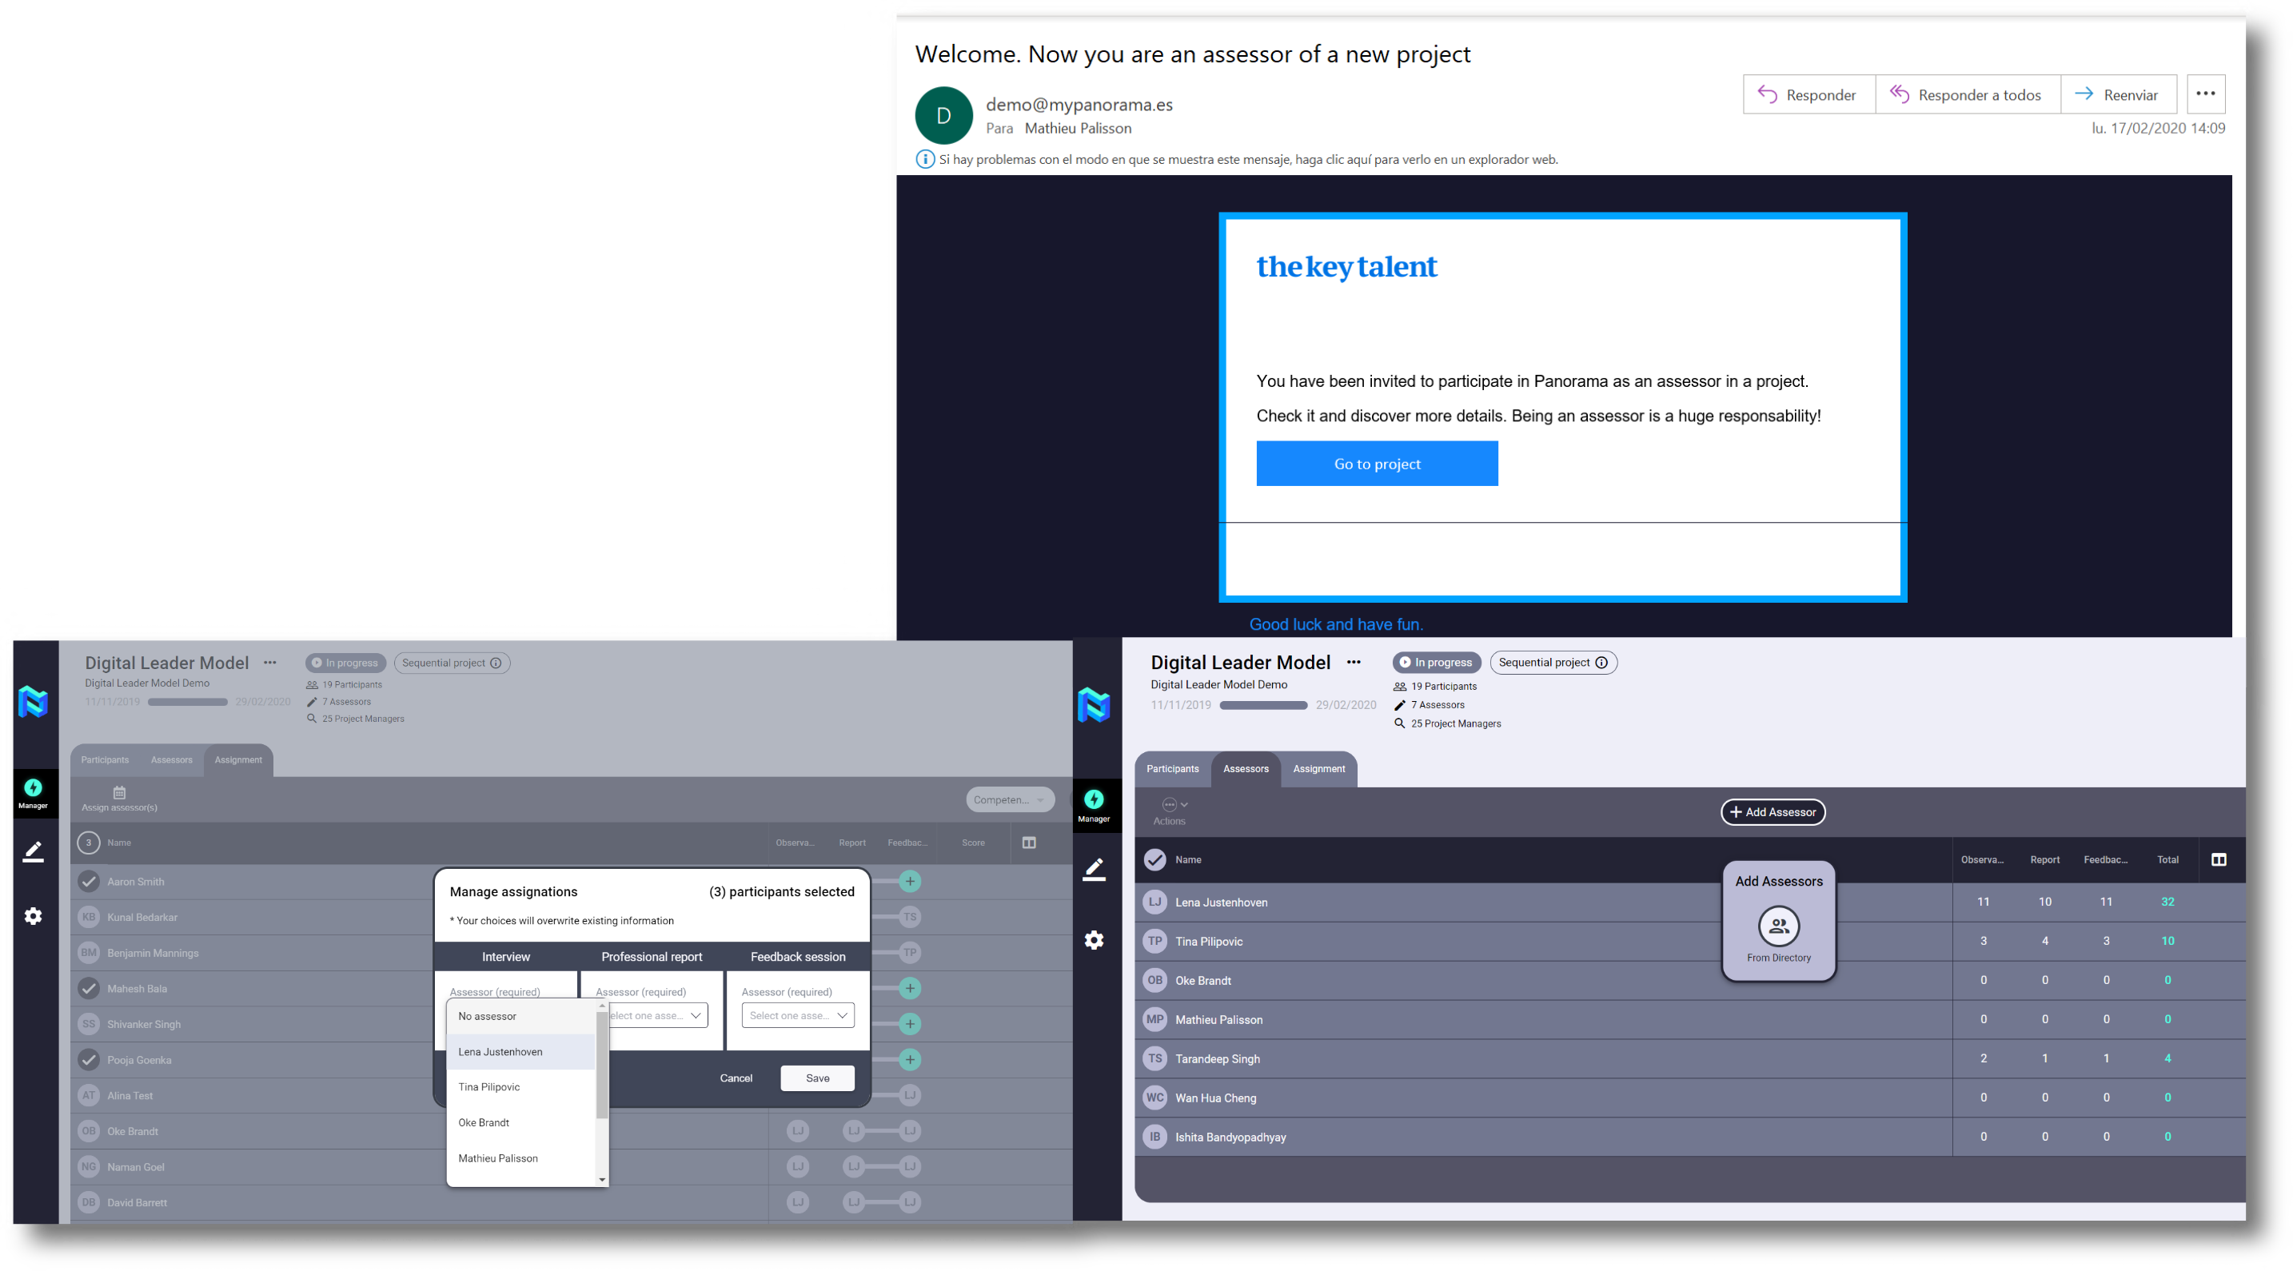

Add and assign assessors
Add your Assessors and assign them to the Participants of the Project quickly and easily.

Slide 21
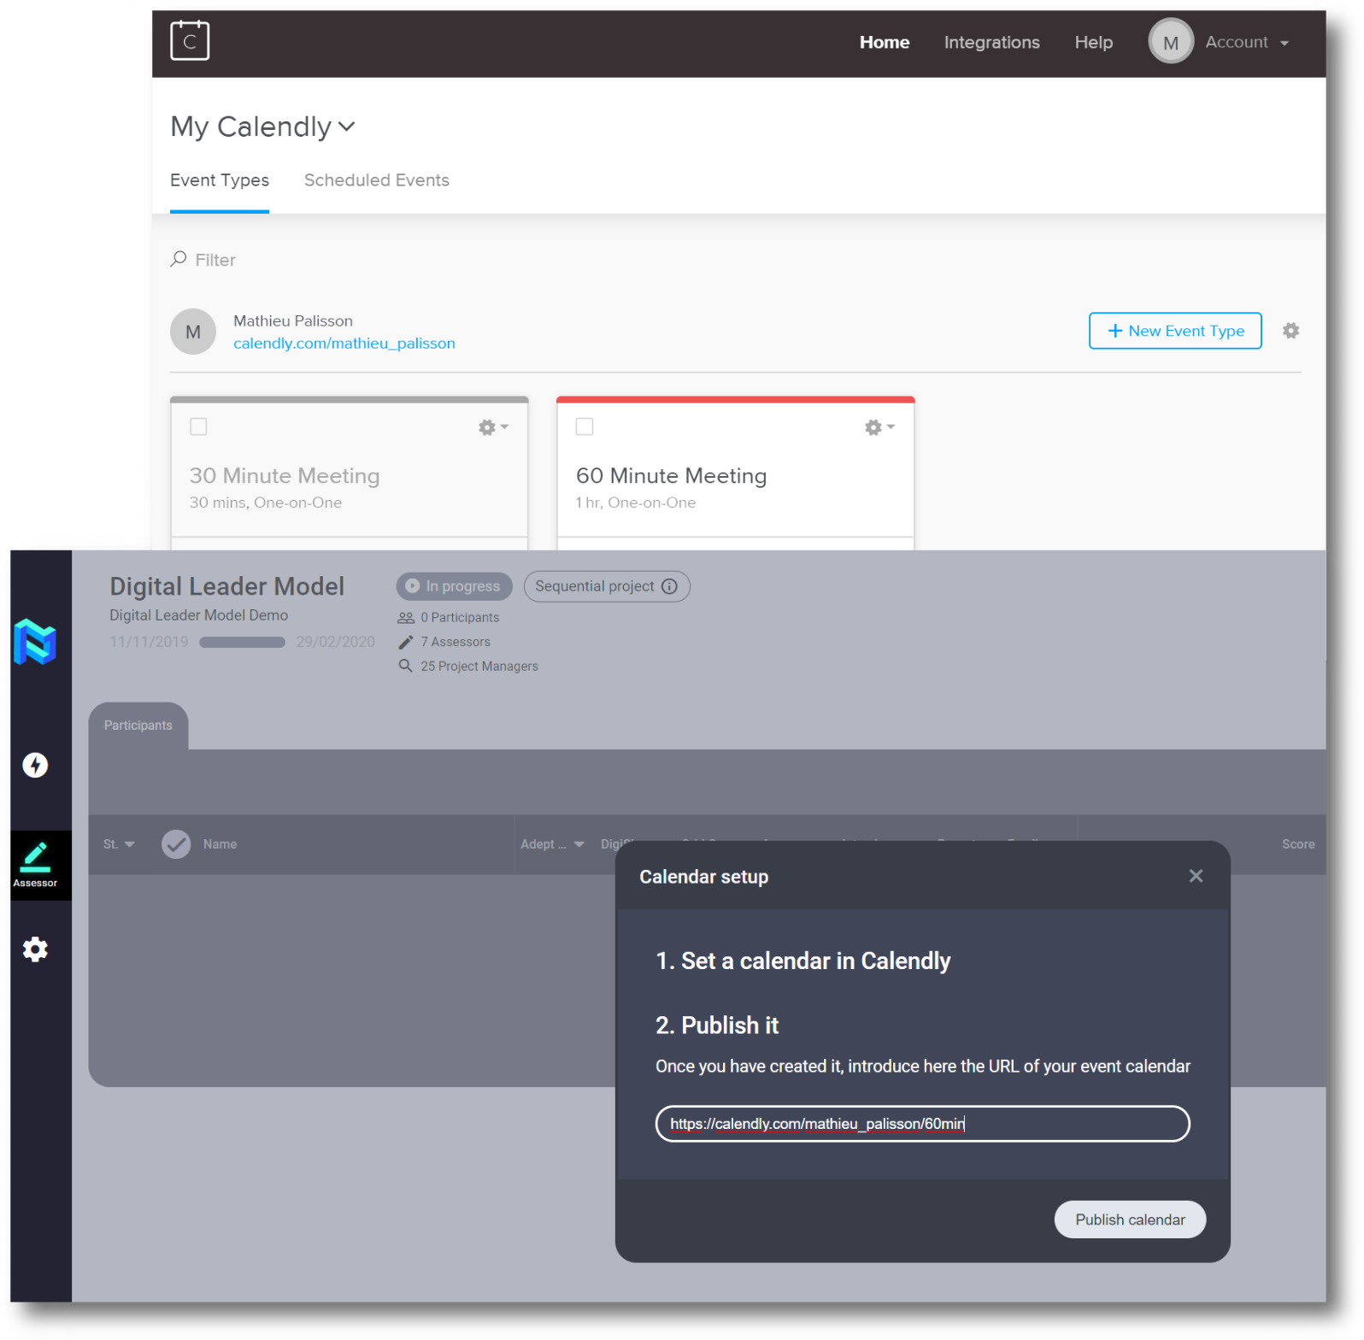
Schedule interviews through Calendly
Schedule your Assessors interviews with their Project Partners quickly and easily through the free third- party tool Calendly, that is seamlessly integrated with all e- mail providers and with Panorama.
Simply copy your link from Calendly and publish it so that participants can schedule their meeting from your Landing Page.

Slide 22
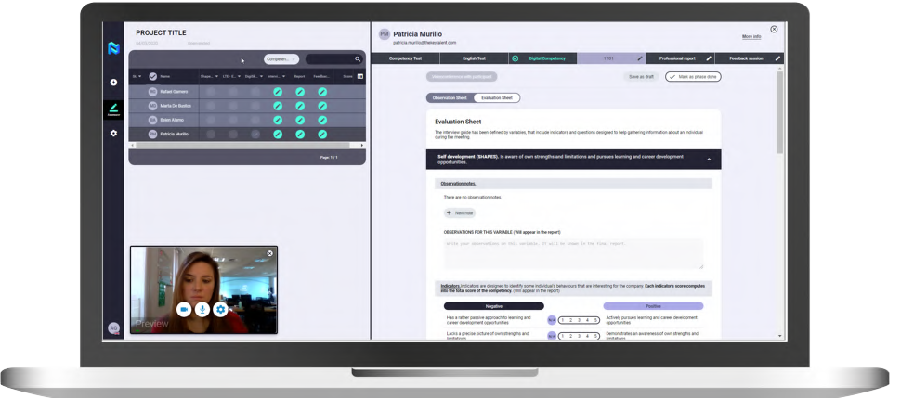
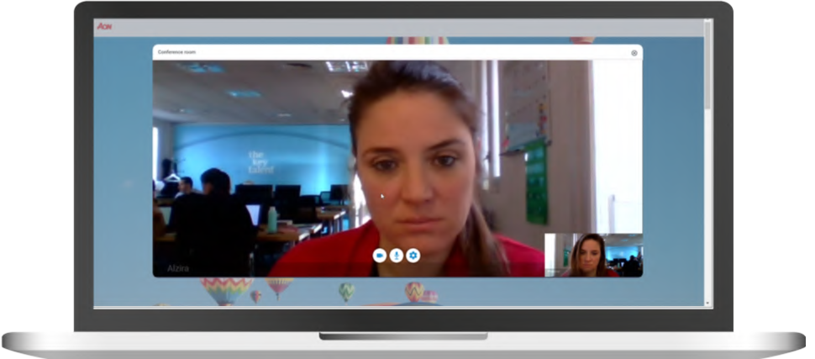
Run interviews through integrated 2-way live interview with possibility to record interview.
No sign-in/log-in required for assessor or participants.
Panorama allows you to conduct online interviews within the tool itself without the need to integrate any third

Slide 23
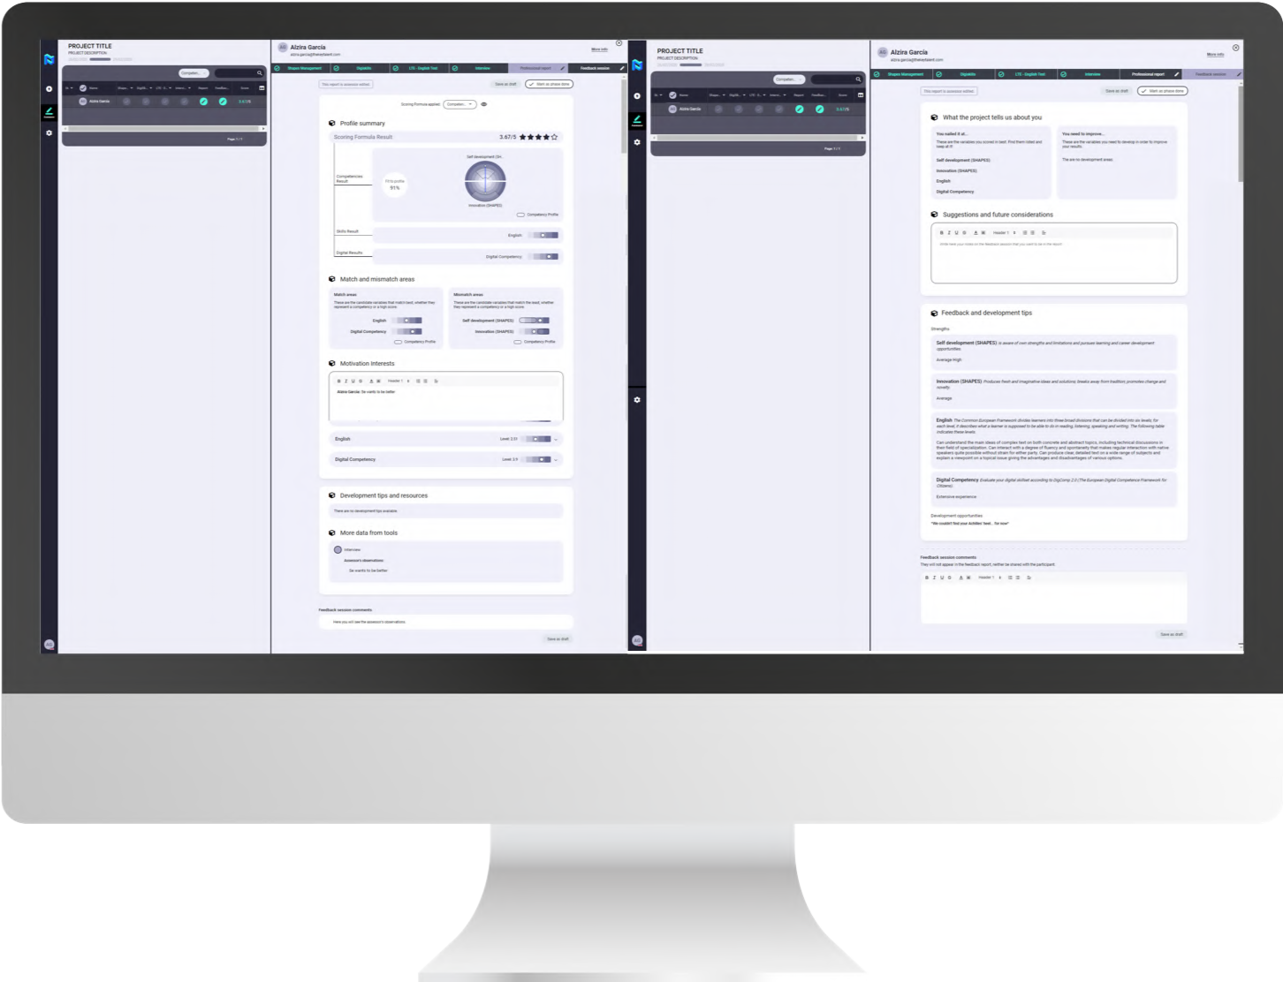
Fill your reports after observation and analysis.
Combine results of tests and interview. Use scoring indicators.
Panorama allows consultants to fill out reports based on the analysis of online test results and interviews conducted previously.

Slide 24
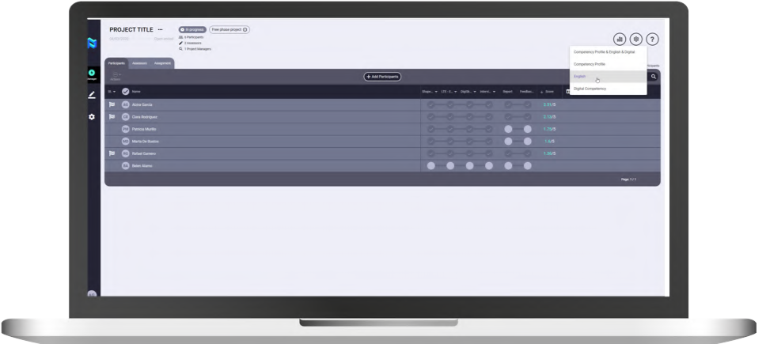
Compare results and take decisions based on data
Panorama allows to compare the results of the participants of a Project in an easy and fast way, both ordering them by the result obtained globally in the tests and by the different reference profiles created previously.

Slide 25
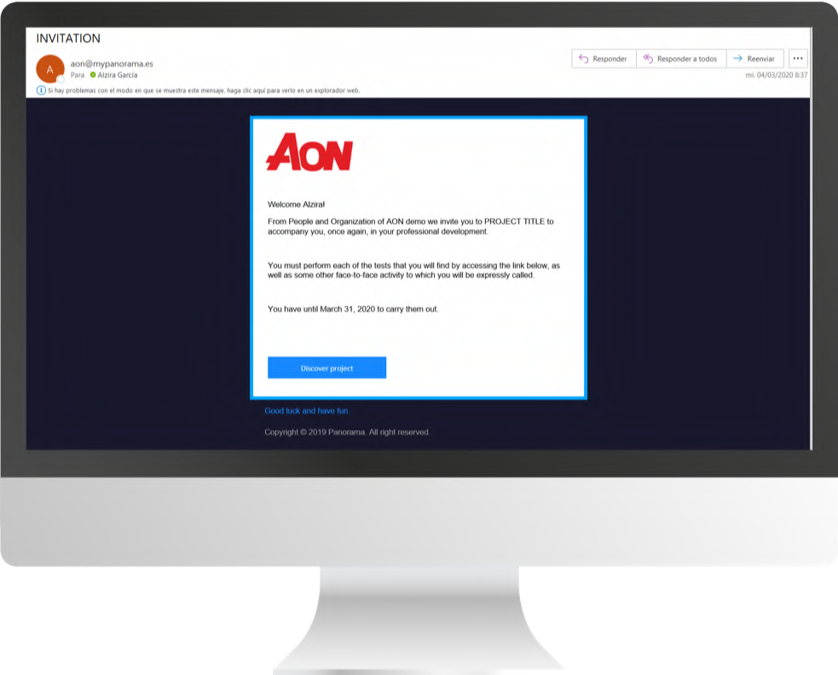
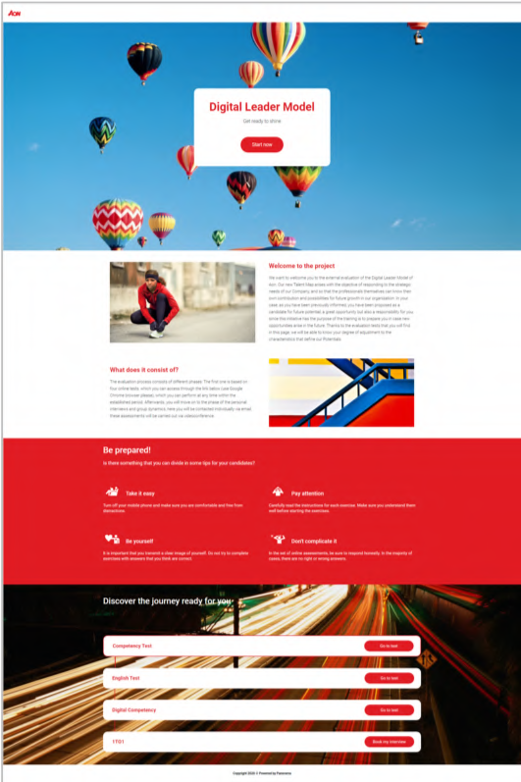
Friendly experience for participants
Access your journey in one click
The participants will be invited to the Project by email, and from there they will be able to access their landing page to start the tests of the Project.

Slide 26
Friendly experience for participants
Easy communication to understand your journey
Both in the invitation e- mail and on the Project landing page there will be clear instructions on what the participant has been invited to do and why.

Slide 27
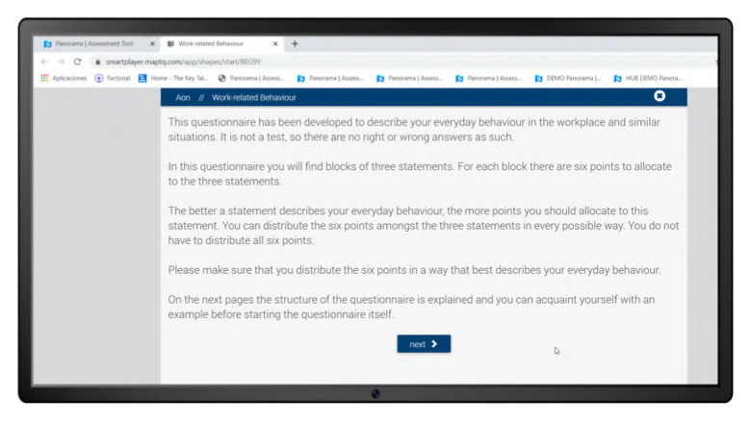
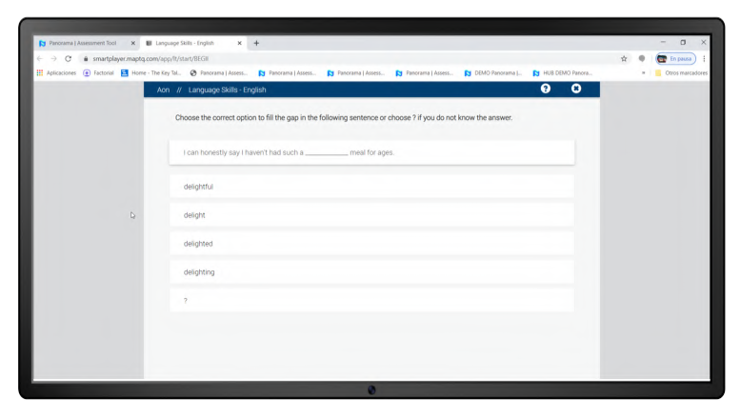
Friendly experience for participants
Take your tests and questionnaires seamlessly (direct integration). No back and forth between platforms.
When accessing any test of the Project the participant does not need to interact with any third-party platform. It is enough with using a web browser on your PC, tablet or mobile.

Slide 28
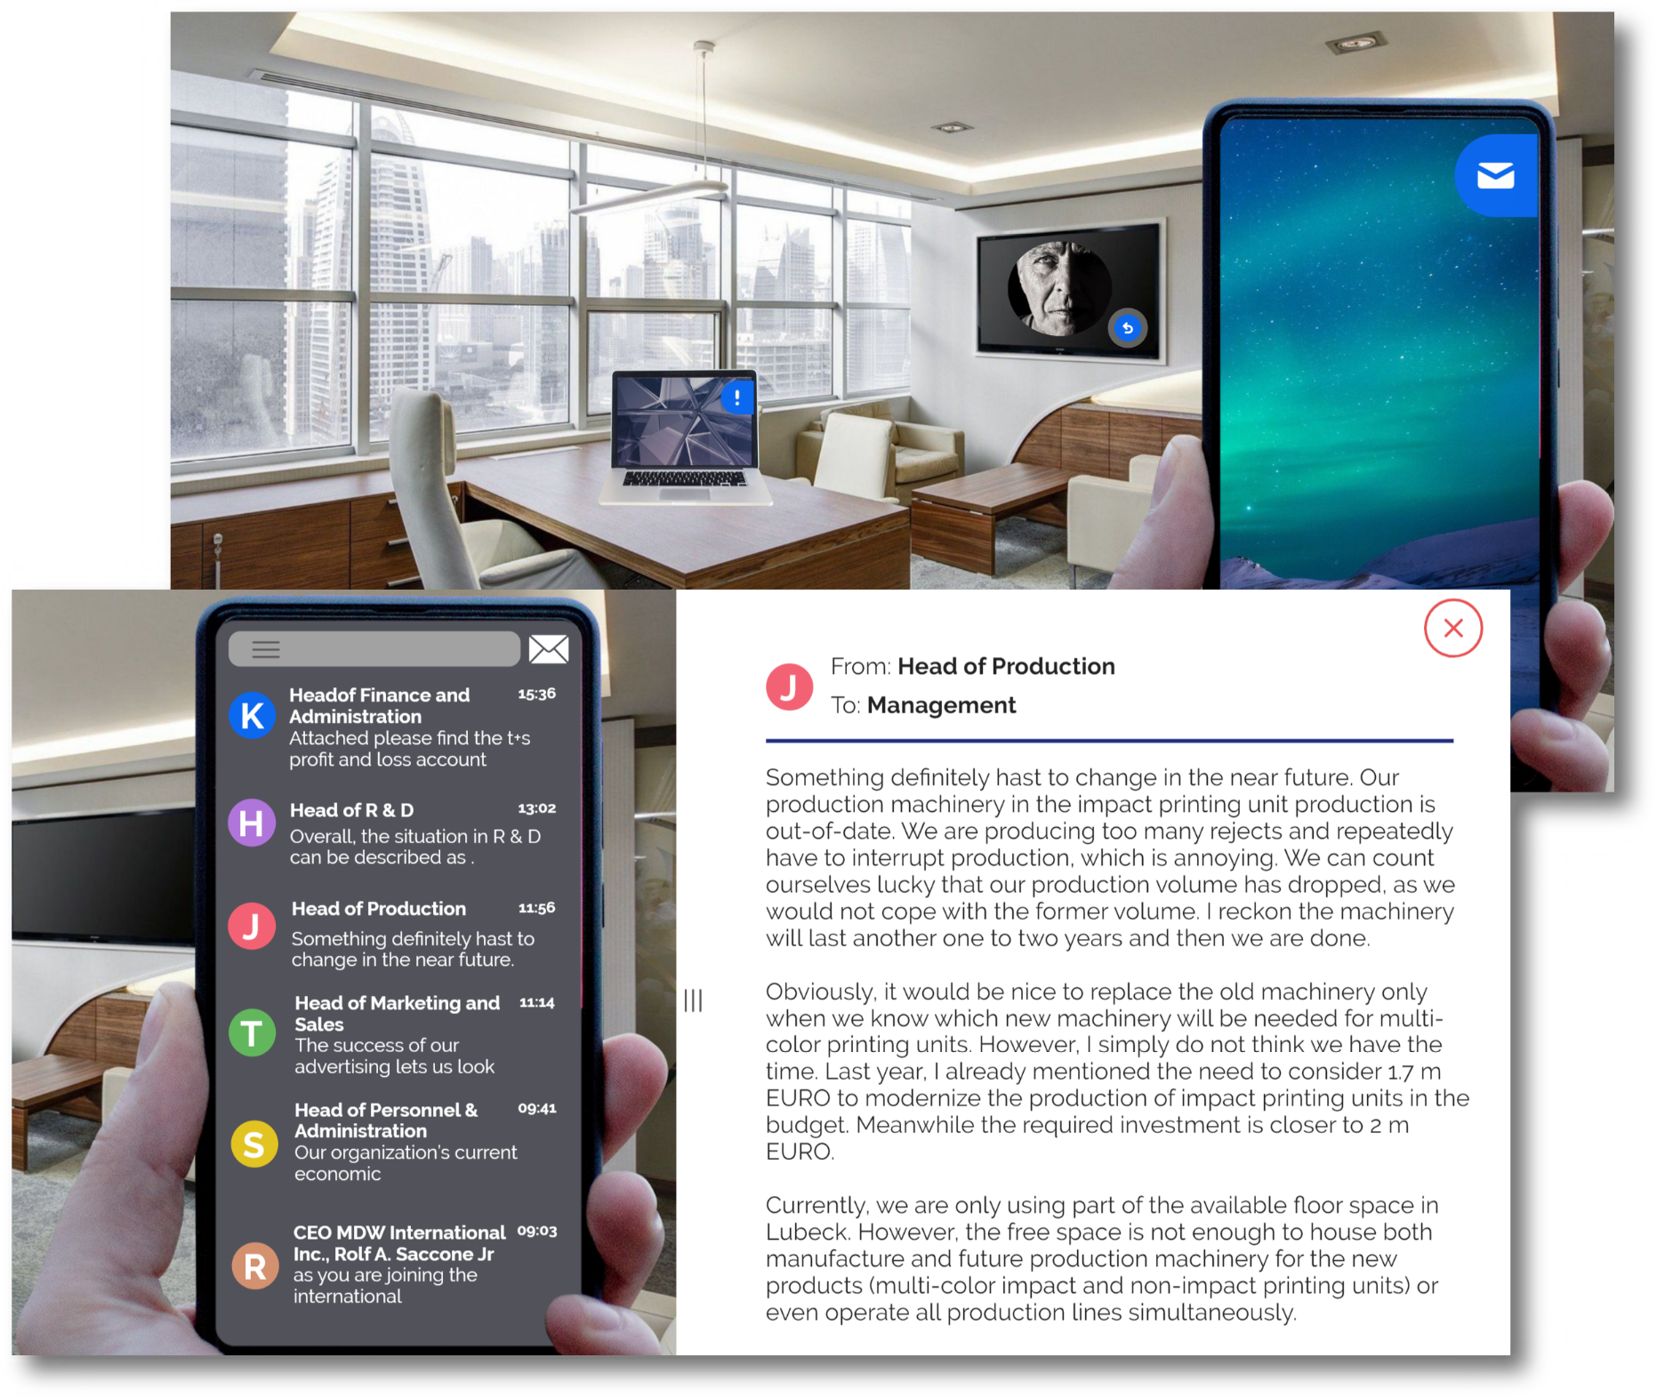
Friendly experience for participants
Receive business cases and roleplays prior to your interview/group exercise
If there is a Business case or a Role Play within the Project, the participant will receive the information from the landing page before carrying out the project.

Slide 29
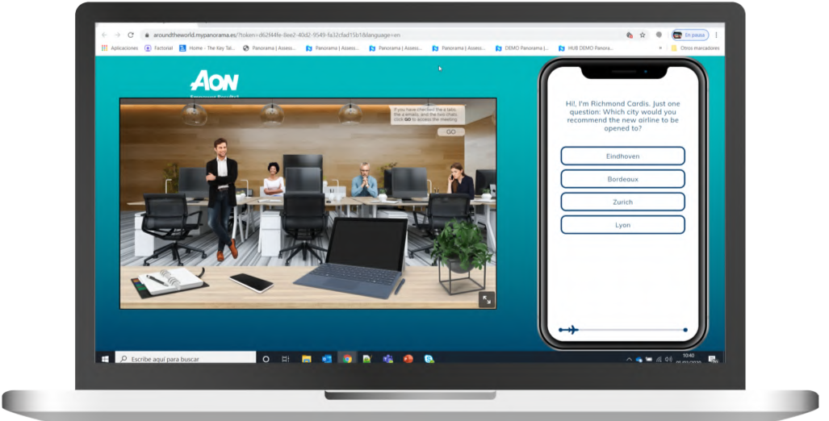
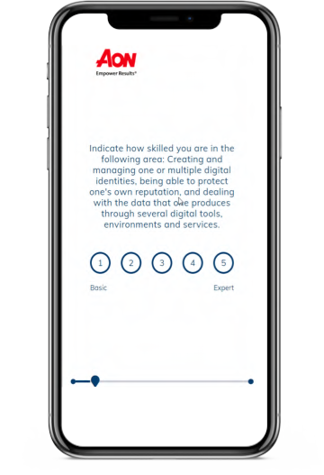
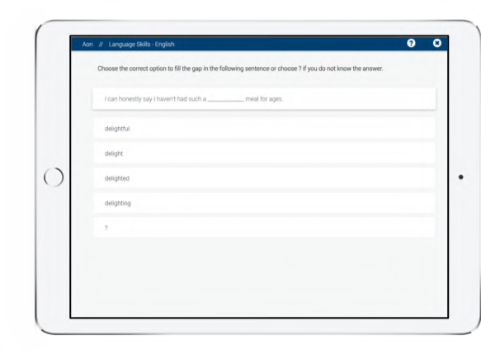
Friendly experience for participants
Engaging way of assessing employees
The ease of communication with participants, as well as the fact that the tests are accessible from any site or device makes Panorama very attractive to your

Slide 30


A new The Key Talent product.
All rights reserved. © 2020.

