Slide 1
Panorama
Sales Deck

Slide 2
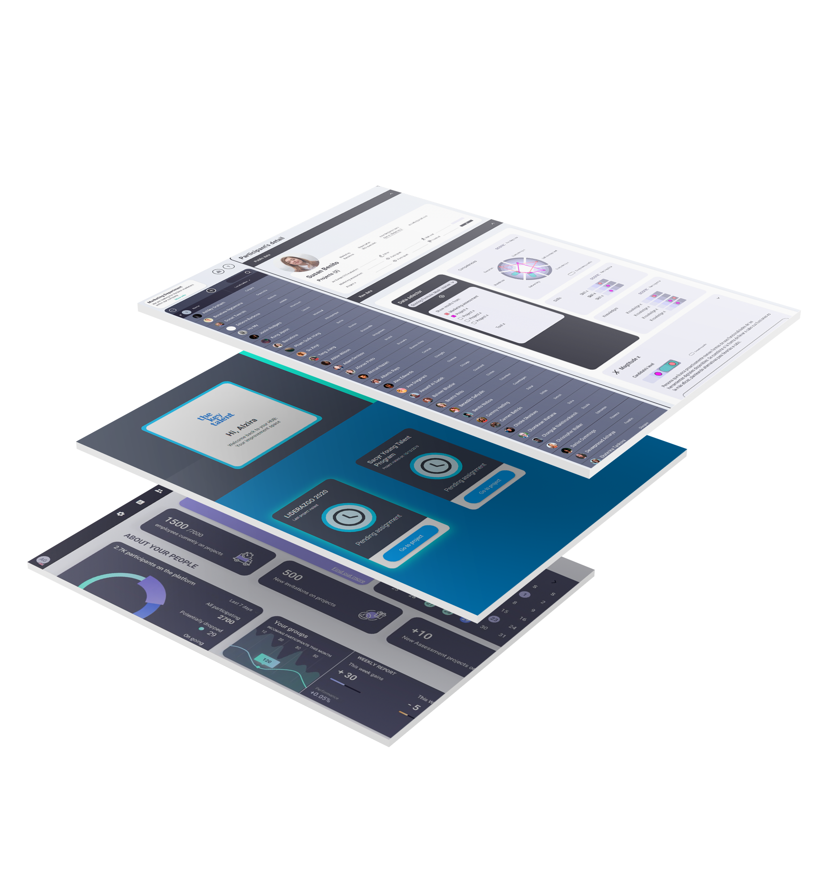
About Panorama
Get to know your employees in detail, make data-based decisions and help them reach their full potential within your company through Panorama.
All in a digital environment that pampers their experience and yours. We have created a platform that goes far beyond remote assessment; evaluating talent has always been a time-consuming and resource-intensive process.
With Panorama, agility and flexibility go hand in hand. From the most sophisticated remote assessment center to an informal knowledge assessment, projects of all sizes and complexities can be started quickly.
All this is possible thanks to the integration of Aon Assessment Solutions’ digital testing in Panorama.

Slide 3
Panorama users
HR Teams
Assessors
Consultants
Employees
Managers

Slide 4
Easy Project creation for HR people
Clients Competencies Dictionary
Panorama speaks your own language, i.e. you can enter your own dictionary of skills, knowledge, abilities, values, and so on.

Slide 5
Easy Project creation for HR people
ADEPT-15 or Digital Leader Model Library
Or you can use the competence models already integrated in the platform such as Adept-15, Digital Leader Model or Shapes.

Slide 6
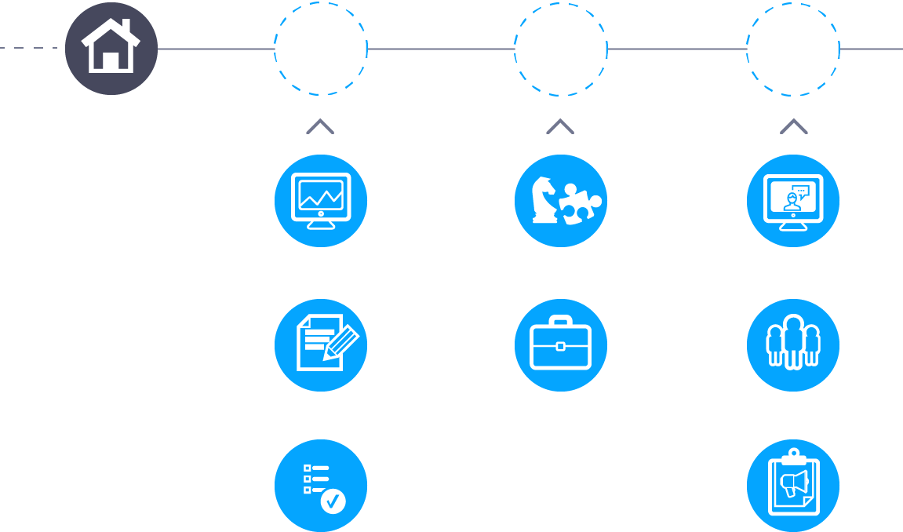
Create flexible journeys
Each Project is a journey in Panorama.
Participants will be invited to advance in a process to measure their abilities and skills in each steps.
Choose variables, competencias, knowledge, abilities…you want to assess from participants and set-up flexible projects.

Slide 7
Create flexible journeys
PANORAMA ALLOWS YOU TO MANAGE MULTIPLE PROJECTS OF A DIFFERENT NATURE SIMULTANEOUSLY
* WHICH MAY BE CONNECTED DEPENDING ON THE RESULTS*...
PROJECT A: ASSESSMENT CENTRE FOR MARKETING
PROJECT B: ONBOARDING
FOR GRADUATES
PROJECT C: ASSESSMENT PROCESS FOR HIGH POTENTIALS
7

Slide 8
On-line assessment library
Select tools to evaluate from AON AS and The Key Talent portfolio (competencies, abilities testing, Case studies, Role Play, interview, etc.)
Select your tools to evaluate the selected variables.
Panorama allows you to integrate your own tools to have them available in the market.

Slide 9
Design your talent “matrix”
Match talent variables with assessment tools
Assign to what extent you want each tool selected for a variable to measure it, assigning a percentage/weight to it.
Customize the name of the tools that will evaluate your participants to make their journey is attractive.

Slide 10
Scoring formula: Build your ideal profile
Build as many reference profiles as you want, to be able to match your participants with them.
Select the variables you want to compare as well as the competencies that will be the base of the reference profiles.

Slide 11
Build your own landing page
Customize your Landing page with your corporate colors, logo, and company text and messages.
Use the Landing Page Builder to help your participants understand the process they have been invited to.
As you create your project, it will automatically design the journey that the participant must follow.

Slide 12
Schedule interviews
Schedule your Assessors interviews with their Project Partners quickly and easily through the free third-party tool Calendly, that is seamlessly integrated with all e-mail providers and with Panorama.
Simply copy your link from Calendly and publish it so that participants can schedule their meeting from your Landing Page.

Slide 13
Run interviews through integrated 2-way live interview.
No sign-in/log-in required for assessor or participants.
Panorama allows you to conduct online interviews within the tool itself without the need to integrate any third party tool.

Slide 14
Fill your reports after observation and analysis.
Combine results of tests and interview. Use scoring indicators.
Panorama allows consultants to fill out reports based on the analysis of online test results and interviews conducted previously.

Slide 15
Compare results and take decisions based on data
Panorama allows to compare the results of the participants of a Project in an easy and fast way, both ordering them by the result obtained globally in the tests and by the different reference profiles created previously.

Slide 16
Friendly experience for participants
Access your journey in one click
The participants will be invited to the Project by email, and from there they will be able to access their landing page to start the tests of the Project.

Slide 17
Friendly experience for participants
Easy communication to understand your journey
Both in the invitation e- mail and on the Project landing page there will be clear instructions on what the participant has been invited to do and why.

Slide 18
Friendly experience for participants
Take your tests and questionnaires seamlessly (direct integration). No back and forth between platforms.
When accessing any test of the Project the participant does not need to interact with any third-party platform. It is enough with using a web browser on your PC, tablet or mobile.

Slide 19
Friendly experience for participants
Receive business cases and roleplays prior to your interview/group exercise
If there is a Business case or a Role Play within the Project, the participant will receive the information from the landing page before carrying out the project.

Slide 20
Friendly experience for participants
Engaging way of assessing employees
The ease of communication with participants, as well as the fact that the tests are accessible from any site or device makes Panorama very attractive to your

Slide 21
A new The Key Talent product.
All rights reserved. © 2020.

